Slide 1
What is Child Sexual Exploitation and Sex Trafficking?
Course: -----------
Notes:
Learning Objectives:
●Introducing the topic of child sexual exploitation and human trafficking to students
● Identifying risk factors and vulnerable groups
● Discussing warning signs of child sexual exploitation
Notes for Educators:
This lesson plan focuses on child sexual exploitation and human trafficking. For many students this might be their first time discussing this topic. Please take some time to review the resources in our website to prepare. Discussions on how some groups might be more vulnerable to being Sexually Exploited will be part of this lesson plan. Be ready to challenge any stereotyping or victim-blaming, and rather focus on the importance of questioning the systematic marginalization of certain groups.
Online Delivery Guide:
Throughout this powerpoint presentation you will find suggested digital tools and platforms for activity implementation in online spaces.
Optional Activities:
This lesson plan was shortened from its original version. Some of its activities were included as “Optional Activities” at the end of this presentation.
Teacher Supervision:
Online technology allows students to engage meaningfully with both course material and their peers. Due to the sensitive nature of the content, be cognizant of the potential for triggering interactions. Your chosen digital toolset should reflect the maturity and sensitivity of your students. For example, you may prefer classroom discussions as they allow for monitoring of discussion if you have concerns about small group interactions without adult supervision.
Accessing Support Material:
Support material is located throughout the accompanying slide decks. Teachers wishing to make use of them are encouraged to download version(s) to their desktop for distribution to students where applicable. Teachers using learning management systems should upload a version of files for students wishing to work asynchronously. Note that all lessons, with the embedded student materials, are available for downloading as both PDF and Word documents on the wrprevent.ca website.
Curriculum Connections:
Exploring Family Studies Gr. 9-10 (HIF10/20):
B1.3 explain the connection between adolescents’ developmental needs and their individual behaviour (e.g., how identity development and the corresponding need to belong to a group can affect social behaviours; how rapid physical development affects behaviours related to sleep and diet)
Equity and Social Justice: From Theory to Practice, Gr. 12 (HSE4M):
B2.1 Analyse the dynamics of power relations and privilege in various social settings, both historical and contemporary
B2.2 Analyse the effects of bias, stereotypes, prejudice, discrimination, and oppression on individuals and groups

Slide 2
In-school resources:
Canada-Wide Resources:
Canadian Human Trafficking Hotline
canadianhumantraffickinghotline.ca
ENG/FR - Online chat available
Hope for Wellness Helpline
hopeforwellness.ca
Offers immediate help to all Indigenous peoples across Canada. ENG/FR - Online chat available
Content warning
and support
Let’s create a class agreement!
Notes:
Content Warning:
For many students this might be their first time discussing sexual exploitaiton and sex trafficking
Remind students that they’ll be discussing a difficult topic and assure them that number one priority throughout the sessions is their well-being.
Remind students that support is available. They can either access school support (social workers, councillors, etc.) or Canada wide resources.
Students should be informed about the presentation content and given the option to not participate in the lesson
Create a class agreement: Ask students share what considerations should be kept in mind to make everyone feel safe (e.g. being respectful towards everyone’s opinions and using respectful language, not joking about sensitive topics, being mindful of how much space we take throughout the session)
Complete this slide with school supports (social workers, counsellors, etc.) available for survivors and/or those who want to make any disclosures, nationwide resources and online information (such as the wrprevent.ca website) can also be made available to students
Creating a class agreement:
It is essential to create a class climate suitable for the seriousness of the topic. Ask students to share what considerations should be kept in mind to make everyone feel safe (e.g. being respectful towards everyone’s opinions and using respectful language, not joking about sensitive topics, being mindful of how much space we take throughout the session, etc.)

Slide 3
Something for you to think about…
What are some warning signs that might help us recognize when someone is being sexually exploited?
Notes:
Activity 1: Slides 3-4 will help you prepare your students for the lesson plan
Students should be given this question at the start of the lesson so that their brains are primed for this targeted learning. Participants could be invited to record and share their initial thoughts about warning signs, continue to add to their list and refine it as the lesson proceeds.
This question will support the task in the next slide.
Digital Delivery Guide: Word Wall
Word walls help students retain new vocabulary. You might consider creating a digital word wall with the new vocabulary words covered in this session
Suggested digital tool:
Padlet http://padlet.com/
Google Doc https://www.google.com/docs/about/
Zoho Docs https://www.zoho.com/docs/
Accessibility is the key to an effective word wall. Students need to be able to refer back to the definitions with ease. A digital word wall creates an online repository of ideas and concepts. Use the following suggestions when creating a digital world wall.
Choose a platform that allows collaborative editing.
Invite students to the Digital word wall

Slide 4
What we will be working towards…
There are so many warning signs that can help us identify when sexual exploitation is happening.
As we discuss them today, record these indicators in a useful way that can help you recognize these signs.
You may wish to create a daily reminder saved in your phone, a personal note that sits by your bedside, or a small poster for your room.
Notes:
Provide these additional details to students to support them as they think about the question in the previous slide throughout the lesson.
This is the task students will be completing at the end of the lesson. This gives students an opportunity to think about how they might record the warning signs throughout the lesson.
Criteria for a useful way to record indicators could be shared with students at this time to guide their thinking:
serves as a good reminder
generally characterizes situations that indicate that a person may be experiencing sexual exploitation
highly visible/easily detected or reminded of
makes you feel more at ease or comfortable with the topic

Slide 5
What is your initial thinking?
Have you heard about child sexual exploitation and sex trafficking?
Could you help us define it?
Notes:
Activity two:
Briefly discuss these questions with students. Once a possible definition has been shared, let students know you will be watching a video on this topic.

Slide 6
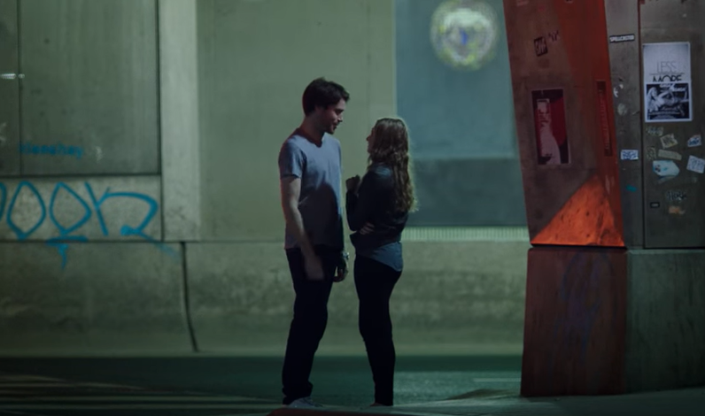
Video “Stop Sex Trafficking in Ontario”
As you watch this video, pay close attention to your reactions to the video.
For example, the video might make you scared or angry, or make you want to protect Amy.
Notes:
Ask students to pay attention to their emotional reactions as they watch the video “Stop Sex Trafficking in Ontario” by Covenant House (2015), and to jot down those reactions, noting the scenes or comments that made them feel a certain way. At the conclusion of the video, give students time to add to their notes, focusing on their emotional reactions and questions. Post the link to the digital handout. Alternatively, create a digital worksheet for students to complete.

Slide 7
Video “Stop Sex Trafficking in Ontario”
How did you feel watching this video?
What thoughts came to mind?
Do you have any questions about it?
Notes:
Some further discussion questions and possible answers.
Was there anything that surprised you about the video?
Possible answers: Answers may vary. I am shocked to know that sex-trafficking takes place in Canada. I did not think sex-trafficking is common in Canada. I am surprised to find Amy did not like the way she looks because I think she looks fine and pretty. From her physical appearance, I would not have imagined Amy having problems with
self-confidence and falling victim to sex-trafficking. I cannot believe the sudden change in Ryan’s personality and how the story turns out. At the beginning, he seemed to be a nice person, but later on in the relationship, he was very aggressive, rude/ demanding, and violent towards Amy. I am surprised that no one, such as her family, friends, school staff, noticed the change in Amy and offered her help. If she worked for 12 hours a day in the sex-trafficking activity and got abused by Ryan, she probably skipped schools frequently and was in a bad mental health state.
Before watching this video, have you heard of sex-trafficking (from the media, internet)?
Possible answers: Before watching this video, I have heard of sex-trafficking in the news, but not in the context of Canada. I woud have thought sex-trafficking takes place in other countries. I have heard of some issues similar to sex-trafficking, like how some people find sugar daddy/mommy to get financial support, luxurious goods, or to pay their tuition fees.
What ways did the sex-trafficker, Ryan, use to exploit Amy?
Possible answers: At first, Ryan tried to date Amy in order to gain her trust. Afterwards, he told her that he had money/ financial problems that he needed Amy to work for him. Ryan complimented Amy and showered her with a lot of attention. When spending time with Ryan, Amy felt really good about herself and seemed to think they would have a future together.
What may be some factors/ reasons that the victim, Amy, did not ask others for help?
Possible answers: Due to shame, guilt, and personal safety (the fear of being harmed by Ryan), Amy did not ask others for help. Amy also thought that her conflicts with Ryan was only temporary and their relationship would return back to normal after she has earned enough money for him.
Who is at higher risk of being targeted by traffickers?
Possible answers: Answers may vary. Based on the video, young girls (about the age of 16 to 24, or even younger) and people with lower self-confidence, negative self-image have a higher risk of being exploited.
Where do sex traffickers recruit other traffickers to exploit youth?
Possible answers: Anywhere, including schools, shopping malls, and online. People need to protect themselves at all times. Sex-traffickers are constantly looking for ways to
recruit new members. Be careful not to disclose personal information to strangers at all times. At the same time, pay attention to people one knows, including close friends, family members, who may have negative influences and may potentially be sex-trafficking recruiters.
What actions can you do to help raise awareness of and prevent sex-trafficking?
Possible answers: Answers may vary. First of all, learning what sex-trafficking is, symptoms of sex-trafficking, and how it happens helps you to be aware of the issues. Knowing the resources and organizations that are available in the community help you to refer others for support. Taking care of your mental health, keeping a positive life attitude and self-image, having a healthy social life with friends and family, caring for people around you, all help prevent people falling victims to sex-trafficking.
When you notice people are involved in sex-trafficking, report the situations to adults you trust, including your teachers, parents/ guardians, and the police, and ask them for support.

Slide 8
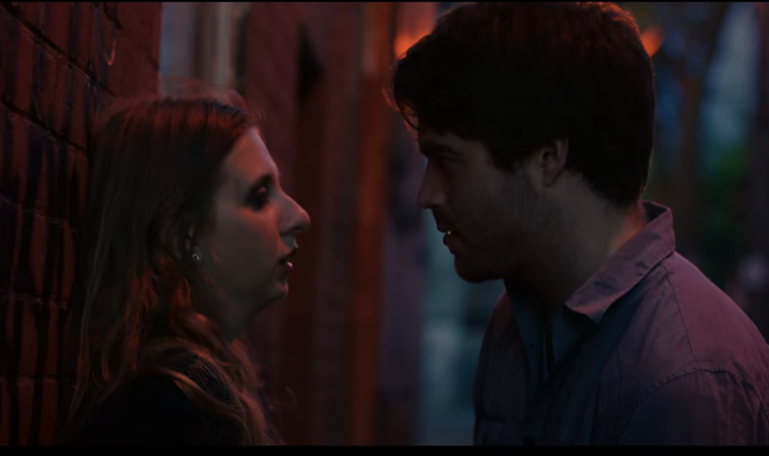
Let’s Discuss
What was this video about?
Was there anything that surprised you in the video?
What was Amy’s and Ryan relationship like?
Notes:
Teachers should note the following key points:
Sex traffickers use many devious ways to lure their victims. E.g. Ryan complimented Amy, showered her with lots of attention. When spending time with Ryan, Amy felt good about herself and seemed to think they would have a future together.
Mention that although the video represents one of the most common child sexual exploitation scenarios of someone being recruited by a trafficker posing as a romantic partner, sex traffickers can also include close friends and family members of all genders. It’s important that students are aware that traffickers are constantly seeking ways to exploit more youth.
Victims often do not ask others for help for a variety of reasons including shame, guilt and personal safety (fear of being harmed). Amy thought her conflict with Ryan was only temporary and that their relationship would return back to normal after she had earned enough money for him.
Please note that this is an excellent opportunity to refer back to to give students an opportunity to add to their notes on indicators/warning signs. If you are doing word wall with new vocabulary, this could also be a great moment to include new words to the wall.

Slide 9
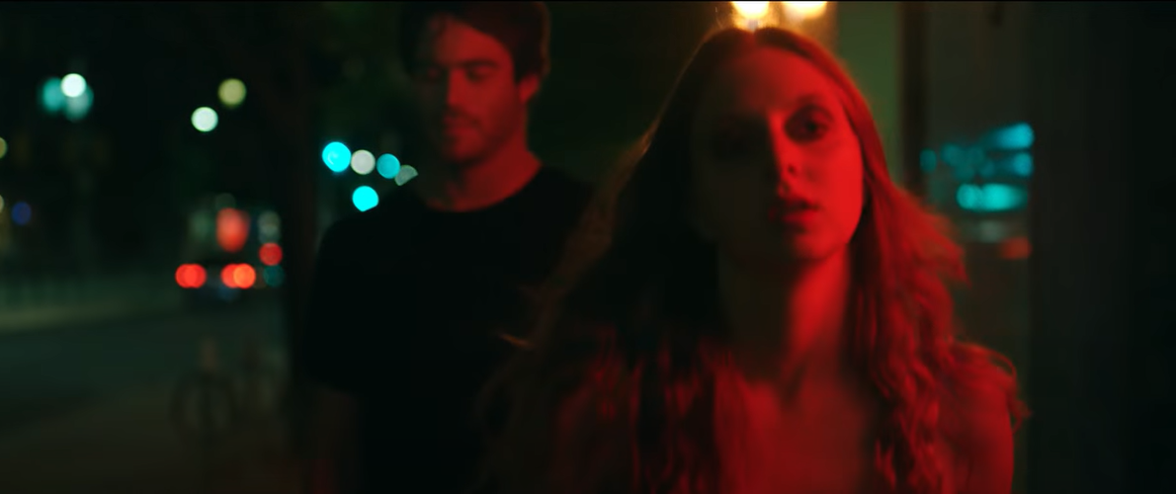
Let’s Discuss
How did Ryan manipulate Amy?
What may be some factors/reasons that the victim, Amy, did not ask others for help?
Notes:
Teachers should note the following key points:
Sex traffickers use many devious ways to lure their victims. E.g. Ryan complimented Amy, showered her with lots of attention. When spending time with Ryan, Amy felt good about herself and seemed to think they would have a future together.
Mention that although the video represents one of the most common child sexual exploitation scenarios of someone being recruited by a trafficker posing as a romantic partner, sex traffickers can also include close friends and family members of all genders. It’s important that students are aware that traffickers are constantly seeking ways to exploit more youth.
Victims often do not ask others for help for a variety of reasons including shame, guilt and personal safety (fear of being harmed). Amy thought her conflict with Ryan was only temporary and that their relationship would return back to normal after she had earned enough money for him.
Please note that this is an excellent opportunity to refer back to to give students an opportunity to add to their notes on indicators/warning signs. If you are doing word wall with new vocabulary, this could also be a great moment to include new words to the wall.

Slide 10
Sexual Exploitation and Sex Trafficking Defined
How does the following definition compare to your initial thoughts at the start of the lesson?
Child sexual exploitation refers to situations where youth are forced or incited to exchange sexual acts or images for material items such as food, shelter, drugs, clothing and/or non-material items such as protection, love, and belonging through the use of power, control and manipulation.
Notes:
Go back to the initial definition(s) students came up with at the beginning of the session and compare it to this definition.

Slide 11
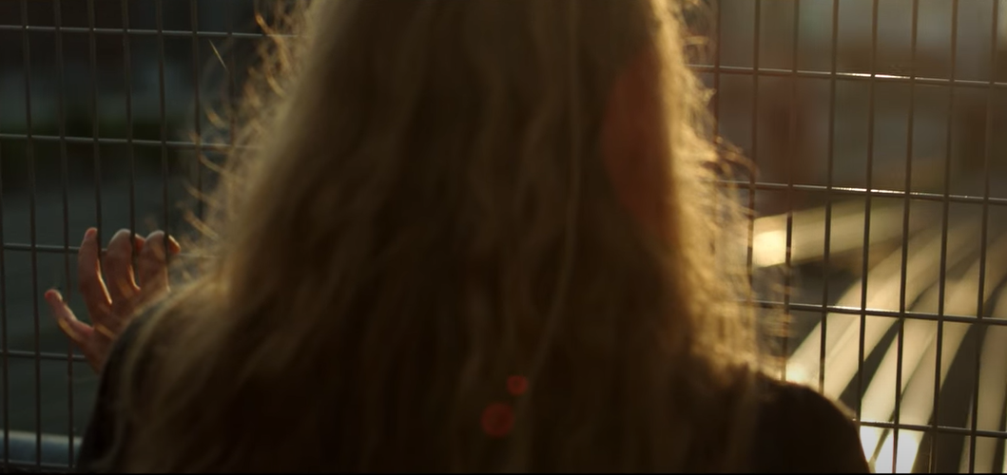
Let’s Discuss
How do you think the 2020 Pandemic has impacted this issue?
Notes:
It’s important that students are aware that traffickers are constantly seeking ways to exploit more youth even during the pandemic.

Slide 12
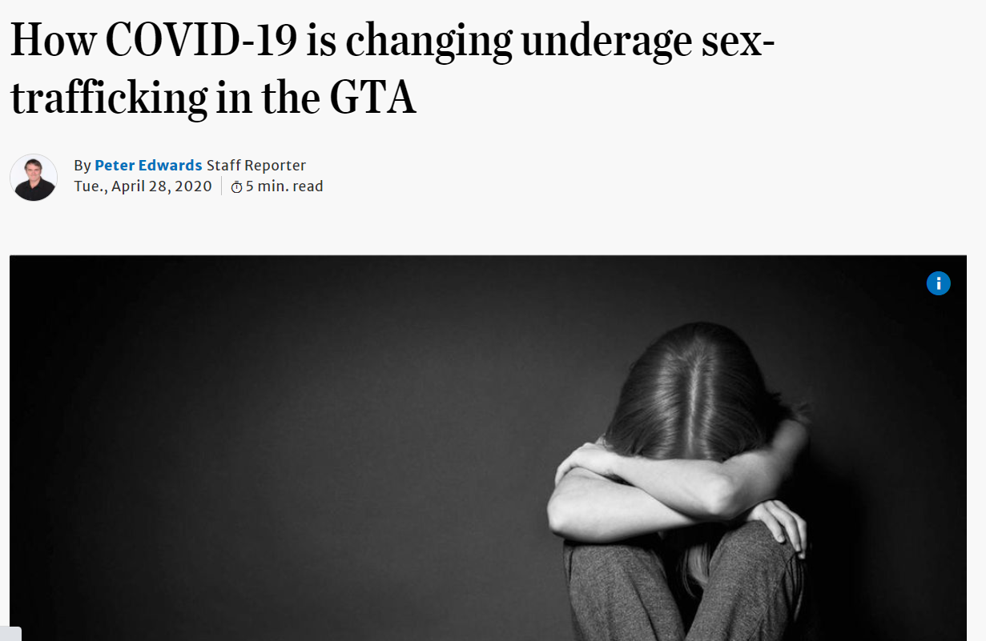
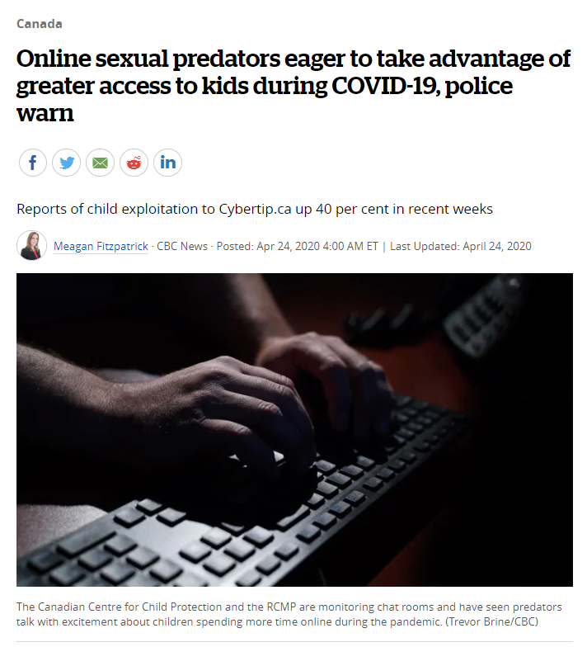
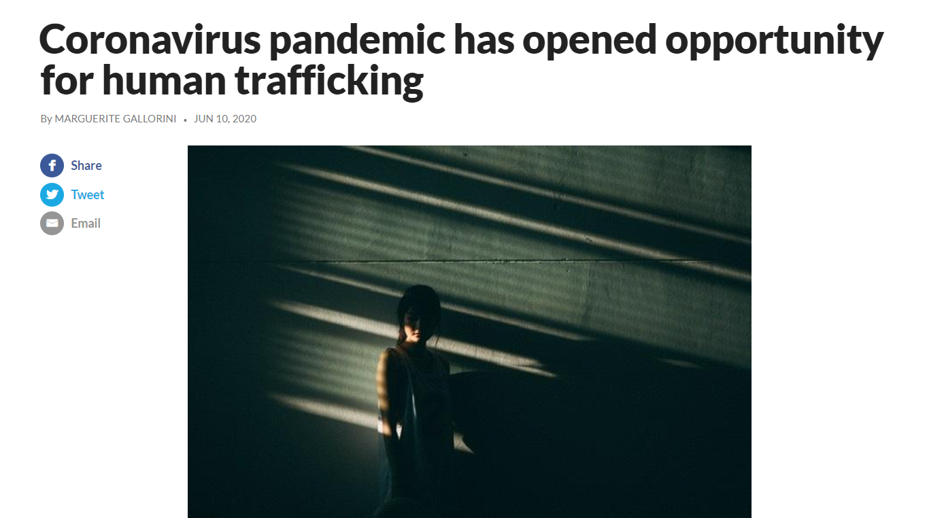
Reported impact of the COVID-19 pandemic
“Sextortion – the act of blackmailing someone online using their nude photos or content as a threat or coercion – is on the rise in Canada during the COVID-19 pandemic [...] There has been an 88-percent increase of sextortion and other online exploitation reports to the tip line since the pandemic began.”
Notes:
The source of this information: Somos, C. “Child ‘sextortion’ reports the rise during pandemic: national tip line.” CTV News. February 9, 2021, https://www.ctvnews.ca/canada/child-sextortion-reports-on-the-rise-during-pandemic-national-tip-line-1.5302282
Note that this is also an opportunity to add the term sextortion to the online Word Wall if you are using one.

Slide 13
Let’s Discuss
Where do you think sex traffickers are targetting their victims?
Who do you think is at higher risk of being targeted by traffickers? Why?
Why is there a demand for sexually exploited youth?
Notes:
This discussion is a good place for teachers to highlight warning signs and remind students to write them down on the recording template. The next slides provide additional indicators related to the above questions.

Slide 14
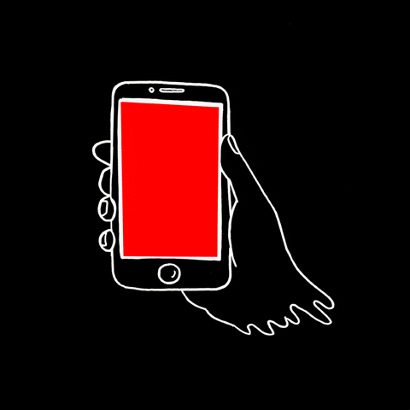
Where does it happen?
Traffickers are approaching youth both in person and online.
Popular social networks such as Facebook, Instagram, Snapchat, TikTok as well as dating applications and live streaming services, are widely used to target vulnerable individuals.

Slide 15
Where does it happen?
After establishing a first contact online, traffickers can take several weeks or just a couple of minutes to exploit youth. Online platforms are used to build trust with their targets in order to arrange in person meetings, to secretly record them and sell their images in child sexual abuse sites, or to blackmail them.

Slide 16
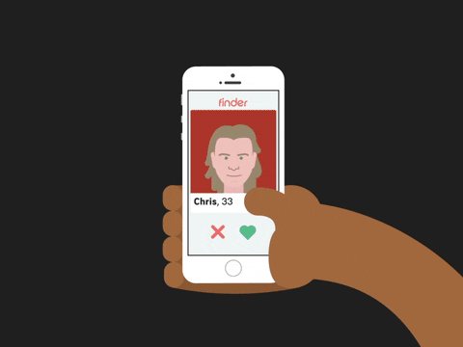
Be careful!
It’s not uncommon for traffickers to display an online persona with numerous friendships, economic success, pictures depicting travelling and luxury, and with many digital markers of status such as likes and followers, as these can be easily bought through the use of fake accounts and ‘bots’.

Slide 17
Who is at higher risk?
Young girls (about age 16-24, or even younger) and those with lower self-confidence and a negative self-image have a higher risk of being exploited. Why does this happen?
Sex traffickers recruit other traffickers to exploit youth anywhere, including schools, malls, and online.
Notes:
Although anyone can be exploited, there are risk factors that make some youth more vulnerable than others, with number one being a girl/woman.
People need to protect themselves at all times. Sex-traffickers are constantly looking for ways to recruit new members. Students need to be careful not to disclose personal information to strangers at all times. At the same time, pay attention to people one knows, including close friends, family members, who many have negative influences and may potentially be sex-trafficking recruiters.
For a definition of Child Sexual Exploitation and Sex Trafficking, please visit: https://www.wrprevent.ca/what-is-sexual-exploitation-and-human-trafficking

Slide 18
Other targeted groups:
Indigenous women and girls
2SLGBTQ+ identified youth
Racialized individuals
Migrants and new immigrants
Persons with disabilities
Children in/exiting the child-welfare system
Children and youth involved in the youth justice system
Homeless and marginalized youth
Notes:
Although anyone can be exploited, there are risk factors that make some youth more vulnerable than others, with number one being a girl/woman.
People need to protect themselves at all times. Sex-traffickers are constantly looking for ways to recruit new members. Students need to be careful not to disclose personal information to strangers at all times. At the same time, pay attention to people one knows, including close friends, family members, who many have negative influences and may potentially be sex-trafficking recruiters.
For a definition of Child Sexual Exploitation and Sex Trafficking, please visit: https://www.wrprevent.ca/what-is-sexual-exploitation-and-human-trafficking

Slide 19
Other targeted groups:
Individuals with mental health and/or addictions needs
Individuals with a history of experiencing violence or neglect
Individuals with a history of child sexual abuse
Neurodiverse, atypical youth (ie, ADHD, autistic)
Socially and economically disadvantaged individuals
Youth experiencing homelessness and missing youth
Youth who question their security and sense of belonging to their community, school or family
Notes:
Although anyone can be exploited, there are risk factors that make some youth more vulnerable than others, with number one being a girl/woman.
People need to protect themselves at all times. Sex-traffickers are constantly looking for ways to recruit new members. Students need to be careful not to disclose personal information to strangers at all times. At the same time, pay attention to people one knows, including close friends, family members, who many have negative influences and may potentially be sex-trafficking recruiters.
For a definition of Child Sexual Exploitation and Sex Trafficking, please visit: https://www.wrprevent.ca/what-is-sexual-exploitation-and-human-trafficking

Slide 20
The impact of colonization:
Indigenous Women and Girls are...
Why do you think this true?
How are we responsible for the vulnerability of Indigenous women and girls when it comes to sex trafficking?
What can we do about this?
4% of the overall Canadian population.
the most common targets for traffickers.
roughly 50% of trafficked victims.
Notes:
The statistics are based on data collected by the Native Women’s Association of Canada.
Note that this situation is a direct impact of colonialism and the legacies of the residential schools which have generated their inter-generational impacts that last to this date.
Young women under the age of 18 represent a quarter of victims. The class can learn more about how Indigenous women and girls are affected in some of the resources shared with these lesson plans. This is another opportunity to add to the online Word Wall.
Depending on the background of the students, teachers may need to spend some time discussing the Residential School System and the findings of the Truth and Reconciliation Commission.

Slide 21
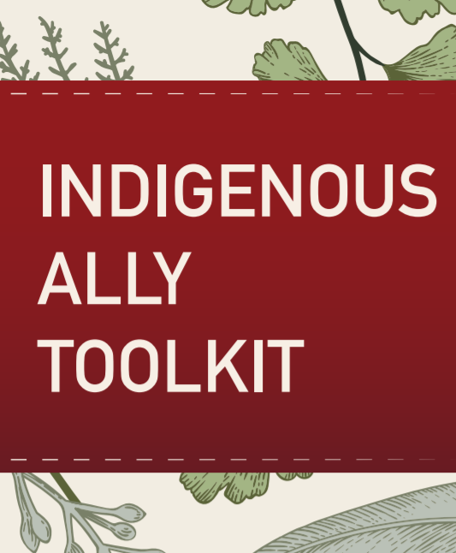
Indigenous allyship, where to start:
Become an active ally to Indigenous communities across Canada
Challenge colonialism and educate others
Look up this “Indigenous Ally Tool Kit”
Visit oncanadaproject.ca/settlerstakeaction
Notes:
Link to the indigenous Ally Toolkit:
https://reseaumtlnetwork.com/wp-content/uploads/2019/04/Ally_March.pdf
Link to On Canada Project:
oncanadaproject.ca/settlerstakeaction

Slide 22
Why is there a demand for sexually exploited youth?
Unfortunately, we live in a culture in which the objectification of women and girls is still pervasive. Female-identified individuals are often presented as objects of consumption and disposal. Non-consensual relationships based on the dominance and control of women and girls by men are often glorified. These foster the attitudes that keep a demand for sexually exploited youth.
Notes:
For sex trafficking and child sexual exploitation to continue to exist there must be a demand.
Often missed in conversations about child sexual exploitation and sex trafficking are the societal and cultural dynamics that enable these exploitative transactions.
The objectification of women and girls in mass media is still pervasive. Female-identified individuals are often presented as objects of consumption and disposal. Non-consensual relationships based on the dominance and control of women and girls by men are often glorified. Sexual encounters, money and material objects, such as cars, clothing and jewelry are often presented in western and westernized communities as metrics to determine the value and status of men.
A key goal of this resource is to help educators facilitate conversations with male-identified students to challenge cultural norms that enable gender-based violence including child sexual exploitation and sex trafficking.

Slide 23
Let’s co-create our list of Prevention and Safety Tips
What actions can we take to help raise awareness of, and prevent sex-trafficking?
Notes:
Activity 3:
The following slides will cover different prevention and response strategies to sexual exploitaiton and sex trafficking. Teachers use a digital white board to record the class list of prevention and safety tips.
Prevention Strategies can include: Learn what sex-trafficking is, symptoms of sex-trafficking and how it happens to build your awareness. Know the community resources and organizations so you can refer others for support. Know how to help prevent people from falling victim to sex-trafficking. Report situations to trusted adults (teachers, parents/guardians, police).
Safety tips can include: Protect yourself at all times. Do not disclose personal information to strangers. Pay attention to the people you know, including friends and family members, who may be negative influences. See the additional resources at wrprevent.ca
The next slide includes important messages about self-care in terms of prevention.
Online Delivery Guide: White Board
Digital white boards allow educators and students to simultaneously add text and images to a single white board document.
While individual teachers will use different online learning systems for student interaction, the most common platforms share similar features.
Suggested Digital Tool:
Digital White Boards are available on Zoom (White Board feature),
Microsoft Teams (Microsoft WhiteBoard feature),
Google Meets (Jamboard feature)
Apart from the suggested tools above, you can also use Google Jamboards (https://jamboard.google.com/) to create a white board. By clicking on the “Share” button can change privacy settings and invite students through e-mail or by sharing a link to collaborate in the same document.

Slide 24
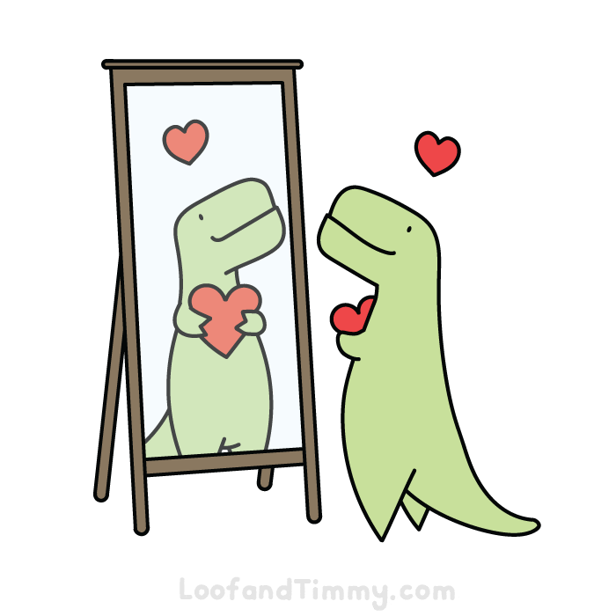
Remember: Self-care is important!
One of the most important ways to prevent becoming a victim of sex-trafficking is taking care of yourself. Here are a few things for you to think about:
Take care of your mental health—get enough sleep, eat well, spend time in nature, and enjoy your life.
Reach out for support if you need it
Spend time with friends and family.
Take care of people around you.
Notes:
Other ideas in terms of self-care can be captured on the white board notes. Students might note ideas for self-care during the pandemic. E.g. taking screen breaks, going outdoors for fresh air and exercise, connecting virtually with classmates, etc.
Note that terms like self-care, well-being, and mental health are possible terms to add to the online Word Wall is using one.
This is a great opportunity for students to continue their notes on indicators/warning signs.

Slide 25
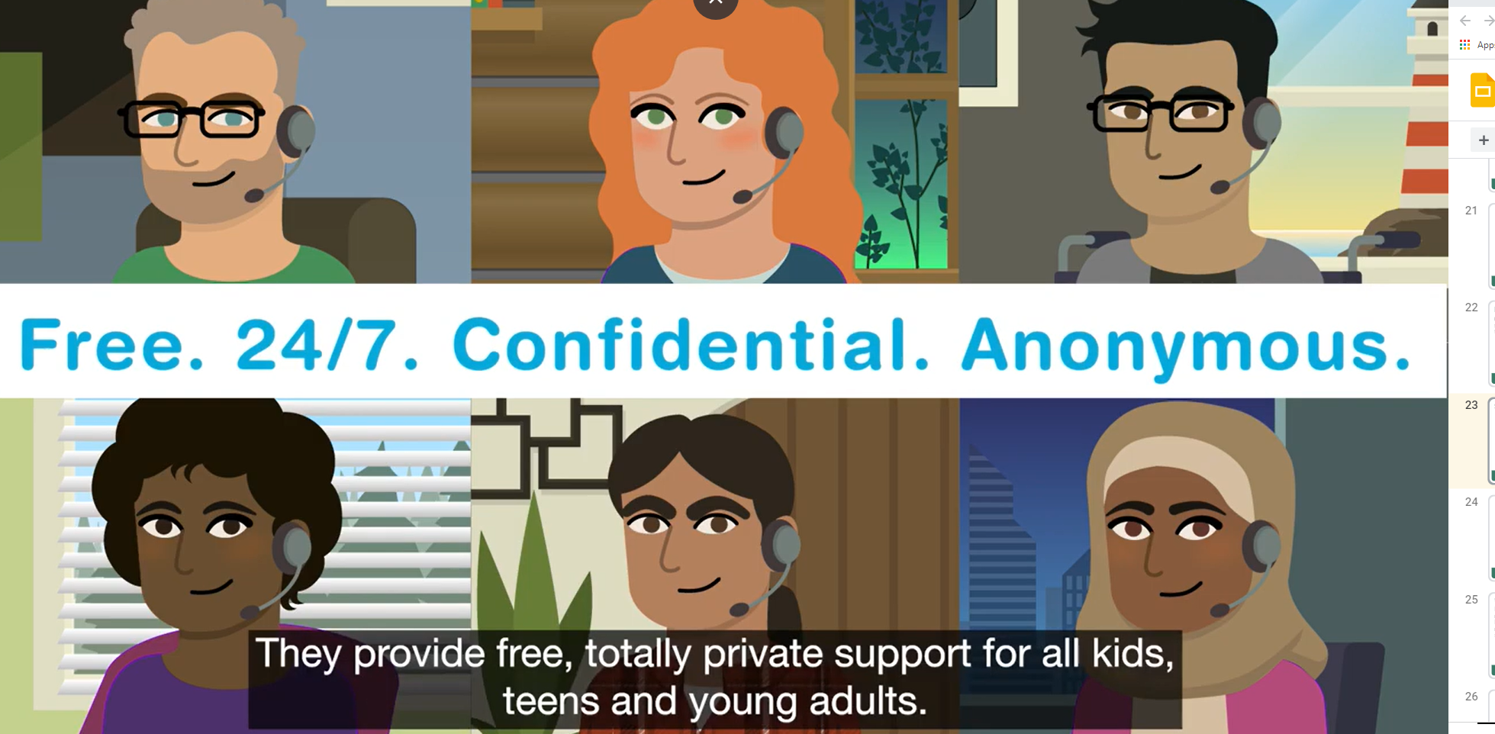
Some resources you can access anonymously
Kids help phone
Text: 686868, Call: 1-800-668-68 or
Chat: kidshelpphone.ca/
or through Facebook Messenger

Slide 26
Some resources you can access anonymously
LGBT Youthline:
Call: 1800-268-9688
Text: 647-694-4275
Chat: youthline.ca

Slide 27
Having Difficult Conversations
What might make it difficult to talk to a friend who you fear may be showing signs or indicators of sexual exploitation?
What might you do to make it less difficult to talk to your friend?
Strategies I can use…
Notes:
The purpose of this section is to offer students ideas to support peers how might be victims of sexual exploitation and sex trafficking.
Ask students to identify how to talk to a friend if you suspect they are being targeted by traffickers. The key idea is that friends should not promise “secrecy” – but instead to talk about how best to involve responsible (a) adult(s) who may be able to help with the situation.
Considerations should include:
● Listening without judgement.
● Not blaming the person for what they are going through.
● Considering our own biases. For instance, it may be hard to understand or empathize with some of the choices others make, or the barriers they experience. It’s important to keep in mind that sexually exploited youth are often manipulated and controlled.
● Be aware of and soften your body language.
● Mirror their language e.g. if they say “boyfriend,” use this term.
● Let them take the lead in sharing, avoid leading the conversation (do not probe for their story -this is the cue to connect with support).
● Avoid making promises you aren’t able to keep (e.g. no confidentiality)The key is to empower students with strategies to have these difficult but necessary conversations. Friends should not promise ‘secrecy’ – but instead talk about how best to involve responsible (a) adult(s) who may be able to help with the situation.
Use an online white board to capture the considerations or strategies students can use when having such difficult but courageous conversations with a friend they suspect is being targeted by traffickers – or – exhibiting signs of other situations or issues in their lives.
Students can also add to their notes on indicators/warning signs.

Slide 28
Who can help?
Important to remember:
Do not promise “secrecy”. Instead, talk about how best to involve (an) adult(s) who may be able to help with the situation.
Find out about community resources and services that can give you more help.
In your school: Who can help, and how might they help?
In your community: What are the resources and services that provide support to end human trafficking?
Notes:
Discuss school and community sources of assistance.
The key is for students to seek the help of a trusted adult(s) if they suspect a student may be targeted by traffickers – or may have other situations or issues in their lives.

Slide 29
Where to get help
In-school resources:
Canada-Wide Resources:
Canadian Human Trafficking Hotline
canadianhumantraffickinghotline.ca
ENG/FR - Online chat available
Hope for Wellness Helpline
hopeforwellness.ca
Offers immediate help to all Indigenous peoples across Canada. ENG/FR - Online chat available
Notes:
Teachers can co-construct this slide with their students to add in-school and community supports for anyone they suspect may be a victim of sex trafficking. It is important to emphasize that child sexual exploitation is happening in Canada at alarming rates. However, there are resources and services that work to provide support and end human trafficking. Note that the link to the Canadian Human Trafficking Hotline has been added. Students can go to that site, find local resources and share their information with the class.

Slide 30
Can you answer this question now?
What are some warning signs that might help us recognize when someone is being sexually exploited?
Notes:
Students should be able to successfully answer this question at the end of the lesson.
This question can be used as an exit ticket to check for student understanding and/or achievement of the lesson goal.

Slide 31
Some warning signs might include:
-Being in toxic/manipulative relationships
-Lost contact with friends and family
-Being secretive or lying about their activities and/or secretive about their “boyfriend” or new friend group
-Having a new tattoo (especially if it is a boyfriend’s name or symbol)
-Having sexualized content on their online profiles
Notes:
Youth can show different signs of being involved in sex trafficking. These might include:
Being defensive and aggressive to exhibiting feelings of fear, anxiety, depression, tension, and submissiveness;
Avoiding eye contact, experience mood swings, have inconsistencies in their stories, and express anxious behaviour regarding law enforcement;
Skipping class and/or withdrawing from friends/activities that they used to be close with;
Being reported as chronically missing;
Having sexualized content on their online profiles;
Being secretive or lying about their activities and/or secretive about their “boyfriend” or new friend group;
Having money, clothes, hair/nails done, hotel room keys, fake ID that they cannot afford/explain;
Having a new tattoo (especially if it is a boyfriend’s name or symbol)
Using drugs/alcohol that they cannot afford/explain;
Frequently speaking about Bitcoin, Airbnb or Hotel Parties;
Exclusively take ride hailing/sharing services, like Ubers and/or taxis to move around, or having different cars picking them up all the time;
Possessing multiple cell phones and often changing their phone numbers.

Slide 32
Use what you learned to protect yourself and others
There are so many indicators/warning signs that can help to identify sexual exploitation.
Record these indicators in a useful way that would help you recognize these signs.
Include some of the things you can do to support the person you suspect is being trafficked
You may wish to create a daily reminder saved in your phone, a personal note that sits by your bedside, or a small poster for your room.
Notes:
Invite students to use what they have learned in this lesson.
You may wish to use this as an assessment task to gather evidence of the quality of your students’ learning.
Remind student to use the following guiding criteria to help them record indicators in the most useful way to them.
Criteria for a useful way to record indicators:
serves as a good reminder
generally characterizes situations that indicate that a person may be experiencing sexual exploitation
highly visible/easily detected or reminded of
makes you feel more at ease or comfortable with the topic

Slide 33
I pledge never to commit, condone, or remain silent about gender-based violence
Take the pledge online: whiteribbon.ca/pledge
Learn more about White Ribbon at:
whiteribbon.ca
@whiteribboncampaign
@whiteribbon
@whiteribboncanada

Slide 34
Other Optional Activities

Slide 35
Optional Activity 1: Sexual exploitation and sex trafficking anticipation guide

Slide 36
Complete the following guide
Individually consider each statement in the Anticipation Guide: Child Sexual Exploitation and Human Trafficking. Circle any words that are unfamiliar to you. Complete the Anticipation Guide by deciding to what degree you believe each statement.
Notes:
The following activity is a Think/Pair/Share using the “Anticipation Guide: Child Sexual Exploitation and Human Trafficking” (page 6) and the “Big Ideas: Sexual Exploitation and Human Trafficking” (page 9) to help facilitate discussion. Both documents can be found at the end of Lesson One. Note that this activity can also be completed with students moving from the individual activity to a whole class sharing and discussion.

Slide 37
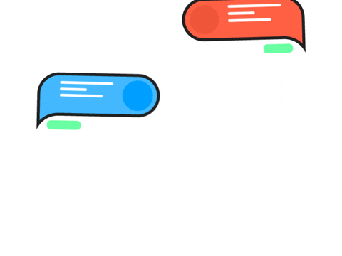
Let’s discuss your answers
As a class or with a partner, discuss your thinking. Use the “Ideas/Questions/Notes” column to add words or phrases to describe any statement where there was disagreement.

Slide 38
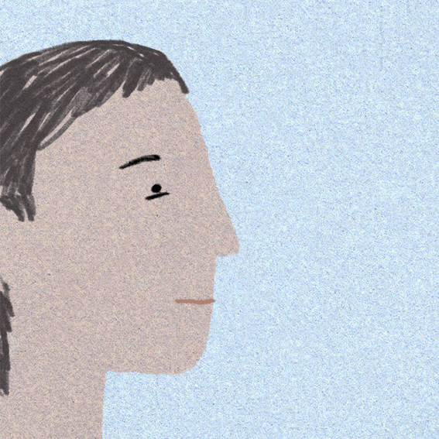
Share
What statement(s) were difficult to talk about? Which were you unsure of the answer? Why?
What statement most challenged your thinking? Why?
What questions do you have about this topic? What are you curious about?
Notes:
Teachers can use a digital white board to capture responses to these questions. Ask students if they have any questions or wonderings. Teachers can go back to the Anticipation Guide and the listed topics/questions on the white board notes at the end of the lesson to make sure that they have all been addressed.

Slide 39
Share
What words did you circle that you do not understand? Are there any others we should add to this list? Star the words that remain unfamiliar to you.
As a class we are creating a digital Word Wall (key terms and definitions) related to the topics of sexual exploitation and sex trafficking.
Notes:
Teachers can ask students to go back to their circled words and star those they still do not understand.
Words like victim, recruitment, luring, grooming and manipulation represent key student learning. From this activity, you will develop a sense of what terms your students are familiar with and what terms they may need to discuss further. Key terms for review and their definitions can be added to the digital Word Wall throughout the eight lessons as students deepen their learning.
Definitions are included in the “Big Ideas” notes for teachers which you can find on page 9 of the original lesson plan. A key element in this discussion is the idea that people can be recruited into child exploitation by offering them not only tangible things like money, drugs, alcohol or goods, but also intangibles like love and social acceptance. Victims may not see themselves as victims as they are being manipulated to feel as if they are in a valued, loving, and/or committed relationship. The idea of trust may also surface in your discussion. Victims end up trusting those who are manipulating them.

Slide 40
What is your thinking now?
Revisit your list of indicators/warning signs and share with the class.
Return to the “Anticipation Guide”. Based on the lesson, would you now change some of your answers using the Likert scale? Why or why not?
Have your questions been answered? Do any questions remain? Share your thoughts.
Notes:
Ask students to revisit their list of indicators. Teachers can lead a class discussion as students share their indicators with the class. Students can also return to the Anticipation Guide. Based on the class discussion, would they now change their answers using the Likert scale? Have their questions been answered? Do any questions remain?

Slide 41
Optional Activity 2: Digital mind maps

Slide 42
What can make us more vulnerable?
Breakout Rooms:
In groups of 2-3, list all the signs you can think of that might make a person more likely to experience (more vulnerable to) sexual exploitation and/or human trafficking.
Ask one member of the group to record key ideas from the group’s discussion. Group your ideas and name the groups so they will be easier to remember.
Notes:
This activity focuses on how some groups might be more vulnerable to being sexually exploited. Be ready to challenge any stereotyping or victim-blaming, and rather focus on the importance of questioning the systematic marginalization of certain groups.
Note that students will be using their notes to create a digital mind map of warning signs/indicators.

Slide 43
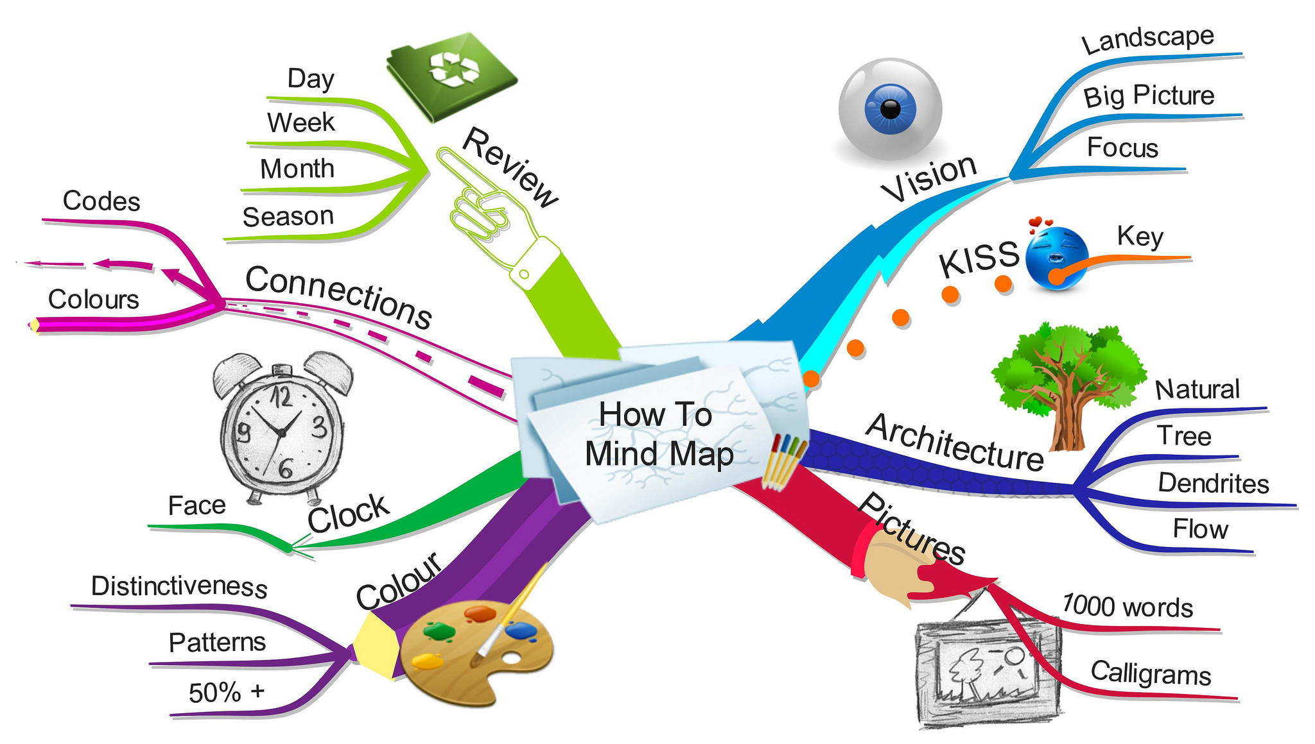
Digital mind map activity
Use the ideas from your group’s list to create a digital mind map of signs or indicators that may make a person more vulnerable to child sexual exploitation and/or human trafficking.
Notes:
Note that teachers need to be sensitive with this list, ensuring that students do not feel targeted. Stress that just because you may identify with many of the identities, it does not mean you will be necessarily targeted.
Talk about stigma, stereotypes, and passing judgment. Students, especially those with privilege, may not see how their circumstances impact what they believe. Be ready to challenge any stereotyping or victim-blaming, and rather focus on the importance of questioning the systematic marginalization of certain groups. This is another opportunity to add terms to the online Word Wall.
Online Delivery Guide: Mind Map
Suggested digital tool:
Creately https://creately.com
Miro https://miro.com
Mindmeister https://www.mindmeister.com
Mindmaps are brainstorming tools that invite students to visually organize information. It invites students to consider the relationships between concepts and ideas. Digital mind mapping allows for both synchronous and asynchronous collaboration. The following steps should inform your use of mind mapping.
Choose a platform that allows collaborative editing.
Familiarise yourself with the graphical elements and functionality of the platform. Find out the range of illustrations, graphic elements, and modification functions.
Remind students that the goal of mind mapping is to visually depict the relationship between ideas and concepts.
Suggest the graphical language for students to use, such as the use of particular colours or shapes to depict certain concepts or the thickness of borders or lines to convey importance or strength.
Create a template with the prompt (question or image) at the center of their mind map. Alternatively, ask students to place the prompt at the center of a blank mind map.
If providing a template, ensure each student team has a different Digital file to work with.
Ask students to include a legend with their mind map to help others read their mind map.

Slide 44
Discussion:
What do certain vulnerable population have in common?
Disempowerment
Lack of networks of support
Loneliness
Disenfranchisement
Marginalization
Oppression
Notes:
This discussion should be done from an awareness and allyship perspective, rather that to stigmatize certain lived-experiences and identities. Students may not be familiar with the terms on this slide. Teachers should use their professional judgement in choosing vocabulary on this slide that would be appropriate for their students. This is also an opportunity to add terms to the online Word Wall. Students can also add to their mind maps.
Teachers can refer to the list of factors provided in Activity Three of the lesson.

Slide 45
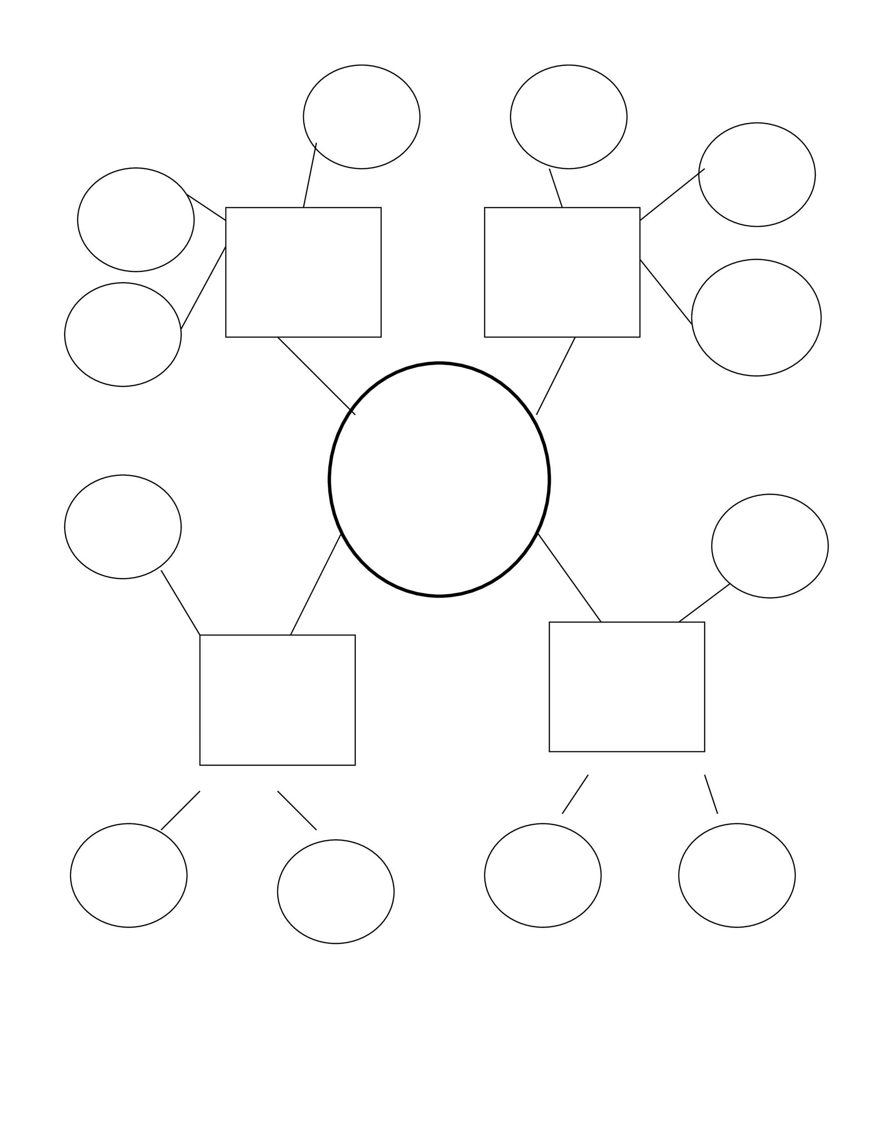
“Warning signs” of child sexual exploitation and/or human trafficking
In groups of 2-3, brainstorm possible actions, attitudes, physical behaviours that might make a person more likely to experience child sexual exploitation and/or human trafficking. Place this information under one of the following headings and add to your group’s mind maps.
A youth who is being sexually exploited may exhibit the following:
Attitudes
Behaviours
Physical Abuse Indicators
Notes:
Note that the following slides pertain to Activity Four in the original lesson plan.
Return students to their previous groups and assign each group one of the following headings: Attitudes, Behaviours or Physical Abuse Indicators. Ask students to brainstorm what the possible warning signs/indicators for each category might be of a person who is being sexually exploited. Each group can then add to their mind maps.

Slide 46
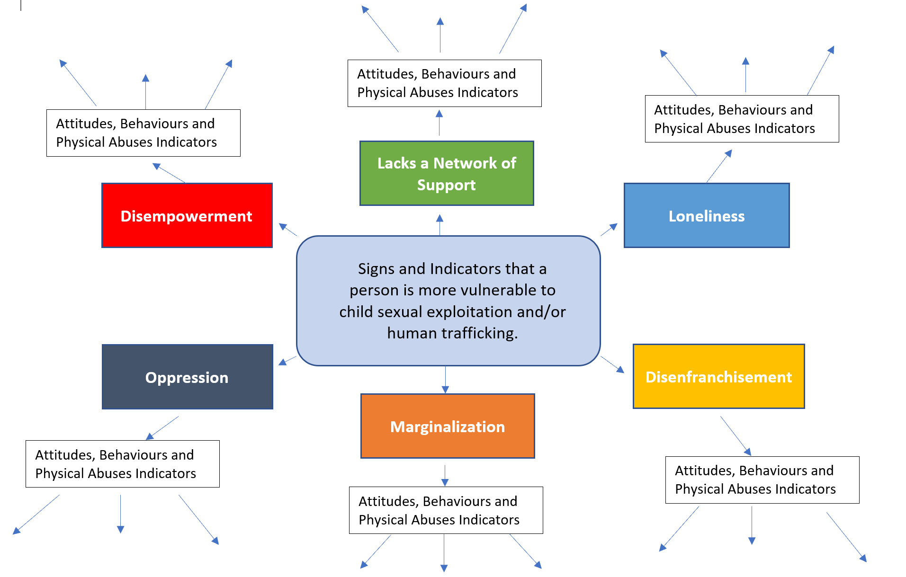
Share your mind maps
In groups, share your updated mind maps with the class.
Jot down any new ideas you could add to your group’s mind-maps.
Revise your mind-maps to include these additional ideas.
Notes:
Students may identify points from the bulleted lists provided in other activities. They may also identify other points. There are no ‘wrong’ answers as the focus is on open dialogue. Groups can share their lists and students can add additional points to their mind maps. Note that the indicators do not necessarily mean someone is being trafficked but could be signs of other situations or issues in their lives.

