Slide 1
Understanding Consent
Course: -----------
Notes:
Learning Objectives:
●Understanding the concept of consent
● Identifying consensual and non-consensual behaviour
● Encouraging safe online dating skills and awareness about sexually exploitative behaviour
Notes for Educators:
In introducing a definition of consent, it is good to also contextualize by providing the concept of consent in realistic scenarios. This exercise allows the group to discuss various sexual and romantic scenarios, including digital interaction, and then explore where we individually and collectively stand on whether specific examples of behaviour are consensual, or possibly exploitative. The exercise allows for honest reflections and dialogue around the gendered barriers and attitudes some young people might be feeling around consent during intimate interactions.
Online Delivery Guide:
Throughout this powerpoint presentation you will find suggested digital tools and platforms for activity implementation in online spaces.
Teacher Supervision:
Online technology allows students to engage meaningfully with both course material and their peers. Due to the sensitive nature of the content, be cognizant of the potential for triggering interactions. Your chosen digital toolset should reflect the maturity and sensitivity of your students. For example, you may prefer classroom discussions as they allow for monitoring of discussion if you have concerns about small group interactions without adult supervision.
Accessing Support Material:
Support material is located throughout the accompanying slide decks. Teachers wishing to make use of them are encouraged to download version(s) to their desktop for distribution to students where applicable. Teachers using learning management systems should upload a version of files for students wishing to work asynchronously. Note that all lessons, with the embedded student materials, are available for downloading as both PDF and Word documents on the wrprevent.ca website.
Curriculum Connections:
Healthy Active Living Education Gr. 9 (PPL1O):
C2.3 apply their knowledge of sexual health and safety, including a strong understanding of the concept of consent and sexual limits, and their decision-making skills to think in advance about their sexual health and sexuality
Exploring Family Studies Gr. 9-10 (HIF10/20):
B1.2 Distinguish between needs and wants, and identify needs, wants, values, and goals that may develop during adolescence
Dynamics of Human Relationships Gr. 11 HD3O):
C1.2 identify characteristics of healthy relationships (e.g., equality, independence, trust, empathy, loyalty, respect, intimacy, honour, recognition of the other’s value, open communication, stability, confidence, altruism)
C2.1 Analyse ways in which social and cultural factors, including portrayals in the media, shape people’s ideas about relationships

Slide 2
In-school resources:
Canada-Wide Resources:
Canadian Human Trafficking Hotline
canadianhumantraffickinghotline.ca
ENG/FR - Online chat available
Hope for Wellness Helpline
hopeforwellness.ca
Offers immediate help to all Indigenous peoples across Canada. ENG/FR - Online chat available
Content Warning
and Support
Let’s create a class agreement!
Notes:
Content Warning:
For many students this might be their first time discussing sexual exploitaiton and sex trafficking
Remind students that they’ll be discussing a difficult topic and assure them that number one priority throughout the sessions is their well-being.
Remind students that support is available. They can either access school support (social workers, councillors, etc.) or Canada wide resources.
Students should be informed about the presentation content and given the option to not participate in the lesson
Create a class agreement: Ask students share what considerations should be kept in mind to make everyone feel safe (e.g. being respectful towards everyone’s opinions and using respectful language, not joking about sensitive topics, being mindful of how much space we take throughout the session)
Complete this slide with school supports (social workers, counsellors, etc.) available for survivors and/or those who want to make any disclosures, nationwide resources and online information (such as the wrprevent.ca website) can also be made available to students
Creating a class agreement:
It is essential to create a class climate suitable for the seriousness of the topic. Ask students to share what considerations should be kept in mind to make everyone feel safe (e.g. being respectful towards everyone’s opinions and using respectful language, not joking about sensitive topics, being mindful of how much space we take throughout the session, etc.)

Slide 3
Something for you to think about…
What does consent mean?
What might it look and sound like?
Notes:
Activity 1:
Slides 3-4 will help you prepare your students for the lesson plan. Students should be given this question at the start of the lesson so that their experiences throughout the next activities are aligned with this targeted learning.

Slide 4
What we will be working towards…
Create your own version of this following organizer on canva to help you remember what consent means, how it might look and sound, and why it’s important?
Definition
What consent looks and sounds like
Consent
What consent does not looks and sounds like
What you can do to foster a consent culture
Notes:
Students will respond to this task at the end of the lesson.

Slide 5
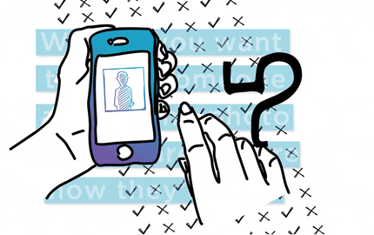
What is your initial thinking?
What is your understanding of the term “consent”?
Individually, jot down your ideas and share them with the class.
Write a draft definition in your organizer.
Notes:
Activity 2:
Ask students to consider this questions and points individually

Slide 6
What is your initial thinking?
“Consent is a voluntary, sober, enthusiastic, creative, wanted, mutual, honest and clear agreement to engage in specific sexual activity. Consent is active: it cannot be coerced or exploited. Consent is a process, which must be granted in the moment of each step of intimate or physical interaction.”
How well does this definition of consent fit with what you believe it means?
Perfect fit!
Fits really well with what I believe
Fits with what I believe a little bit
Doesn’t fit at all with what I believe.
Notes:
Ask students to compare this definition with their own. You can use a poll to ask the question in this slide.
Digital Delivery Guide: Online Polls
Suggested digital tool:
Mentimeter https://www.mentimeter.com
Kahoot https://kahoot.com/
Poll function in your online learning system
Inviting student feedback is a helpful diagnostic tool that can help prompt discussion. There are numerous online polling platforms to choose from. When dealing with sensitive topics, ensure that submissions are anonymous and easily accessible (eg. they do not need registration). The following suggestions should inform your polling:
Familiarize yourself with the setting functions of the platform.
Select the appropriate poll to allow a student to provide original comments.
Adjust the settings as required (eg. You may wish to adjust the number of responses per student.)
Create the quiz prior to the lesson using the question prompts.
When conducting the poll, use the sharing function to display the poll results to students.

Slide 7
Deepening your thinking…
Classify the words in the upcoming list as
-“Asking for Consent is” (change the font to green)
or
-“Asking for Consent is NOT” (change the font to red)
Notes:
Please note that studies show that 2SLGBTQ+ people experience higher rates of intimate partner violence, where the sexual violence 2SLGBTQ+ people is often downplayed as 'just flirtatious' or 'not real violence’

Slide 8
Consent is… Consent is not...
Sober - Sexy - Assumed - Hot - A turn-off - Phone sex - Mutual - Awkward- Being shamed or pressured to do something - Necessary even in 2SLGBTQ+ relationships - Sharing intimate details about your partner with your friends - Talking about what feels good - Saying yes with hesitation - Agreeing to hook up in the days leading up to the event - Going on a date - Sexting - Agreeing to a drink - Sharing sexy pictures with one another - Needed
Notes:
Please note that studies show that 2SLGBTQ+ people experience higher rates of intimate partner violence, where the sexual violence 2SLGBTQ+ people is often downplayed as 'just flirtatious' or 'not real violence’

Slide 9
Consent is… Consent is not...
Arranging a date from a dating App - Sending an unrequested personal picture - Cool- Sliding into someone’s DM’S - Agreeing to seek privacy together -Inviting someone to come over- Inviting someone to your bedroom -Stalking someone after figuring out on social media where they live - Doing what you are told - Filming someone without their knowledge - Pressuring
Notes:
Please note that studies show that 2SLGBTQ+ people experience higher rates of intimate partner violence, where the sexual violence 2SLGBTQ+ people is often downplayed as 'just flirtatious' or 'not real violence’

Slide 10
But before we start: Keep in mind these questions
Which words were difficult to place?
Which words were obvious?
Does anyone want to share why they might not agree with where any words are?
Notes:
The group can debrief around the challenges they might have had placing some of the words on a side. This exercise can open up into the conversation for students around the feelings and attitudes some might have about consent and exploitation.
This exercise allows for people to engage in discussion and unpack scenarios where people might be unsure of whether a specific behaviour is harassing or exploitative, or explore so-called ‘gray areas’ around language or actions. Areas to explore include both the distinct and similar pressures various genders face in conversations within short-term, new, or even long-term committed relationships.

Slide 11
Extend your thinking
Why is consent important to have healthier relationships and end sexual violence?

Slide 12
Scenarios to deepen your thinking
As a class or in groups answer the these questions about the following scenarios:
Are there any red flags in your scenario?
Why are they red flags?
What would be the best decision for the people involved in the scenarios?
Notes:
Activity 3:
Tie the conversation to child sexual exploitation and how digital spaces are increasingly used by Human Traffickers to gain trust and compliance from vulnerable youth in order to exploit them.

Slide 13
Scenarios: let’s discuss
Paula met Don in a dating App. It’s been three weeks since their first conversation and he is already promising her a “better future” and “eternal love”
Carla and Jim get along very well over a dating app. Jim, however, continuously makes their conversation very sexual and requests intimate pictures from Carla
Within their first conversations in a dating App, Alex promises Aiden various gifts and nights out at luxurious places

Slide 14
Scenarios: let’s discuss
Jo and Sam started talking on a dating app. After a while, Jo reveals that they are actually 2 years older than the age listed on their profile
Jordan sent private pictures to Marion over a dating app. Marion tells Jordan that they could sell those pictures for some extra cash.
You meet someone online and share with them that your parents are strict. They tell you “your parents will never change” and invite you to escape with them

Slide 15
Green flags in online dating: let’s discuss
What are some “green flags” in online dating? Make a list of signs that indicate a safe approach.

Slide 16
Let’s make a change
What does consent mean?
What might it look and sound like?
Notes:
Activity 5:
This is the start of the Wrap-Up of the lesson.
Discuss how often unhealthy gender expectations on masculinity pressure male-identifying individuals to be sexually aggressive/dominant and disregard the importance of asking for consent.
Finish by mentioning that there is nothing wrong with online dating, yet safety precautions are very important as dating applications are widely used by Human Traffickers to groom young people.

Slide 17
Check your thinking…
How does your understanding compare to this definition now?
Consent is a voluntary, sober, enthusiastic, creative, wanted, mutual, honest and clear agreement to engage in specific sexual activity. Consent is active: it cannot be coerced or exploited. Consent is a process, which must be granted in the moment of each step of intimate or physical interaction.

Slide 18
What is your thinking now?
“Consent is a voluntary, sober, enthusiastic, creative, wanted, mutual, honest and clear agreement to engage in specific sexual activity. Consent is active: it cannot be coerced or exploited. Consent is a process, which must be granted in the moment of each step of intimate or physical interaction.”
How well does this definition of consent fit with what you believe it means?
Answer the following Poll anonymously:
Perfect fit!
Fits really well with what I believe
Fits with what I believe a little bit
Doesn’t fit at all with what I believe.
Notes:
Note that this is the launch of Activity One in this lesson. We will come back to this slide at the end of the lesson (See slide 24.) to see the extent to which student thinking has shifted as a result of the lesson.

Slide 19
Make a change!
Complete the following organizer to help you remember what consent means, how it might look and sound, and why it’s important?
Definition
What consent looks and sounds like
Consent
What consent does not looks and sounds like
What you can do to foster a consent culture

Slide 20
I pledge never to commit, condone, or remain silent about violence against women and girls
Take the pledge online: whiteribbon.ca/pledge
Learn more about White Ribbon at:
whiteribbon.ca
@whiteribboncampaign
@whiteribbon
@whiteribboncanada

Slide 21
Other Optional Activities

Slide 22
Optional Activity 1: Safety, consent and online dating

Slide 23
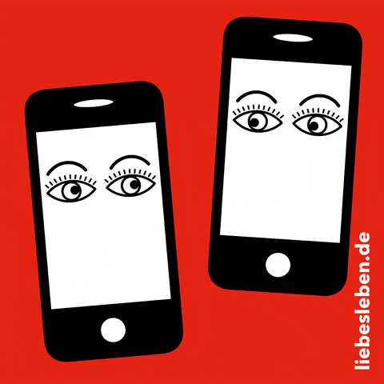
Let’s talk about online dating!
What are the various apps that are used to meet others including potential romantic or sexual partners?
How safe are they?
Extremely Safe
Safe
Okay
Not safe
Extremely unsafe
Notes:
The purpose of this optional activity is to discuss consent and online safety. You can use a poll to ask the question in this slide.
Digital Delivery Guide: Online Polls
Suggested digital tool:
Mentimeter https://www.mentimeter.com
Kahoot https://kahoot.com/
Poll function in your online learning system
Inviting student feedback is a helpful diagnostic tool that can help prompt discussion. There are numerous online polling platforms to choose from. When dealing with sensitive topics, ensure that submissions are anonymous and easily accessible (eg. they do not need registration). The following suggestions should inform your polling:
Familiarize yourself with the setting functions of the platform.
Select the appropriate poll to allow a student to provide original comments.
Adjust the settings as required (eg. You may wish to adjust the number of responses per student.)
Create the quiz prior to the lesson using the question prompts.
When conducting the poll, use the sharing function to display the poll results to students.

Slide 24
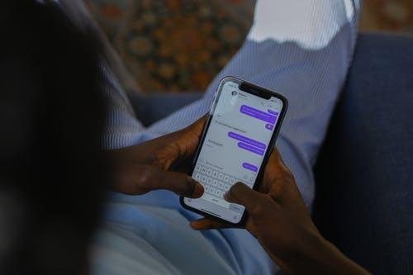
Safety when dating online
What are some safety precautions you might take when dating online?
Notes:
Teachers can use a digital white board to build a comprehensive list.
Online Delivery Guide: White Board
Digital white boards allow educators and students to simultaneously add text and images to a single white board document.
While individual teachers will use different online learning systems for student interaction, the most common platforms share similar features.
Suggested Digital Tool:
Digital White Boards are available on Zoom (White Board feature),
Microsoft Teams (Microsoft WhiteBoard feature),
Google Meets (Jamboard feature)
Apart from the suggested tools above, you can also use Google Jamboards (https://jamboard.google.com/) to create a white board. By clicking on the “Share” button can change privacy settings and invite students through e-mail or by sharing a link to collaborate in the same document.

Slide 25
Check your thinking…
Did you consider any of the following ideas?
Respecting boundaries
Taking things slowly
Not using any kind of pressure or threats
Non-controlling behaviour

