Slide 1
What is Sexual Exploitation and
Sex Trafficking and
How Can I Stay Safe Online?
Notes:
Learning Objectives:
Making students aware of sex trafficking in Ontario and associated online risks
Providing concrete ways in which students can protect themselves from being targeted by sex traffickers in online spaces.
Creating an outlet for advocacy against sex trafficking to prevent and end this crime
Notes for Educators:
There are many myths surrounding sex trafficking. You will need to gauge the level of knowledge/awareness of your students and decide if you need to spend more time on certain areas of the lesson than others. Review the Preventing Sex Trafficking: Online Safety Tips - for educators to become more familiar with online safety strategies.
Online Delivery Guide:
Throughout this powerpoint presentation you will find suggested digital tools and platforms for activity implementation in online spaces.
Teacher Supervision:
Online technology allows students to engage meaningfully with both course material and their peers. Due to the sensitive nature of the content, be cognizant of the potential for triggering interactions. Your chosen digital toolset should reflect the maturity and sensitivity of your students. For example, you may prefer classroom discussions as they allow for monitoring of discussion if you have concerns about small group interactions without adult supervision.
Accessing Support Material:
Support material is located throughout the accompanying slide decks. Teachers wishing to make use of them are encouraged to download version(s) to their desktop for distribution to students where applicable. Teachers using learning management systems should upload a version of files for students wishing to work asynchronously. Note that all lessons, with the embedded student materials, are available for downloading as both PDF and Word documents on the wrprevent.ca website.
Materials:
Projector and access to the internet
Video and/or article featuring survivors of sex trafficking in Ontario
Access to student computers OR if computer access is limited, white paper, markers, pencil crayons Photocopies of “Preventing Child Sexual Exploitation: Online Safety Tips” handout
Jamboard- if using online format
Preventing Sex Trafficking: Online Safety Tips - For educators
Curriculum Connections
Health and Physical Education. Gr 7 Active living, Healthy living:
D1.1 describe benefits and dangers, for themselves and others, that are associated with the use of computers and other digital technologies (e.g., benefits: efficiency and time savings; increased access to information; improved communication, including global access; dangers: misuse of private information; negative impact on mental health, including possible social isolation, feelings of depression, and addiction; identity theft; cyberstalking; exposure to online predators, including those involved in sex trafficking and/or soliciting explicit sexual images; hearing damage and/or traffic injuries associated with earphone use; financial losses from online gambling), and identify protective responses.
D2.2 assess the potential impact on themselves and others of various types of bullying, abuse, exploitation, or harassment, including homophobic bullying or harassment and other forms of identity-based bullying, and of the type of coercion that can occur in connection with sexting and online activities, and identify ways of preventing or resolving such incidents (e.g., communicating feelings; reporting incidents involving themselves or others; encouraging others to understand the social responsibility to report incidents and support others rather than maintaining a code of silence or viewing reporting as “ratting”; seeking help from support services; learning skills for emotional regulation; using strategies for defusing tense or potentially violent situations).

Slide 2
In-school resources:
Canada-Wide Resources:
Canadian Human Trafficking Hotline
canadianhumantraffickinghotline.ca
ENG/FR - Online chat available
Hope for Wellness Helpline
hopeforwellness.ca
Offers immediate help to all Indigenous peoples across Canada. ENG/FR - Online chat available
Content Warning
and Support
Let’s create a class agreement!
Notes:
Content Warning:
For many students this might be their first time discussing sexual exploitaiton and sex trafficking
Remind students that they’ll be discussing a difficult topic and assure them that number one priority throughout the sessions is their well-being.
Remind students that support is available. They can either access school support (social workers, councillors, etc.) or Canada wide resources.
Students should be informed about the presentation content and given the option to not participate in the lesson
Create a class agreement: Ask students to share what considerations should be kept in mind to make everyone feel safe (e.g. being respectful towards everyone’s opinions and using respectful language, not joking about sensitive topics, being mindful of how much space we take throughout the session)
Complete this slide with school supports (social workers, counsellors, etc.) available for survivors and/or those who want to make any disclosures, nationwide resources and online information (such as the wrprevent.ca website) can also be made available to students
Creating a class agreement:
It is essential to create a class climate suitable for the seriousness of the topic. Ask students to share what considerations should be kept in mind to make everyone feel safe (e.g. being respectful towards everyone’s opinions and using respectful language, not joking about sensitive topics, being mindful of how much space we take throughout the session, etc.)

Slide 3
Sex trafficking and Online Safety
In this activity, you will be learning about:
The meaning of the term sex trafficking.
Where it happens.
Who is at risk of becoming a victim.
Who commits this crime.
Online safety.
As you become better informed, think about how the information presented helps you:
better understand the dangers of sex trafficking.
stay safe from online sex traffickers.

Slide 4
Think about the following questions
Reflect on the following questions and jot down your initial thoughts.
What is sexual exploitation and sex trafficking?
Where does it happen?
Who is at risk of being targeted for child sexual exploitation and sex trafficking?
Who can be a perpetrator (a person
committing a crime)?
Notes:
Activity One
Learning objective:
Making students aware of sex trafficking in Ontario and associated online risks
This is a whole class activity where students can share their thoughts in-class or via their mic or chat box (if online). Begin by explaining to students that you will be discussing the topic of sex trafficking in Ontario with the purpose of dispelling common myths about this crime. You will also be discussing ways children and teens can stay safe from sex traffickers online.
Suggested digital too online:
Zoom -whiteboard room https://zoom.us
Google meet- Jamboard https://meet.google.com
This whole class activity provides students with the opportunity to reflect and refine their thinking on a topic as a large group. interactive whiteboards allow students to share their ideas without occupying the same physical space. Keep the following in mind when using whiteboards/jamboards:
Provide the class with clear directions for each slide
Decide if you want students to out their names after their answers
Keep your answers appropriate for the class setting, be mindful of the potential experience of others.

Slide 5
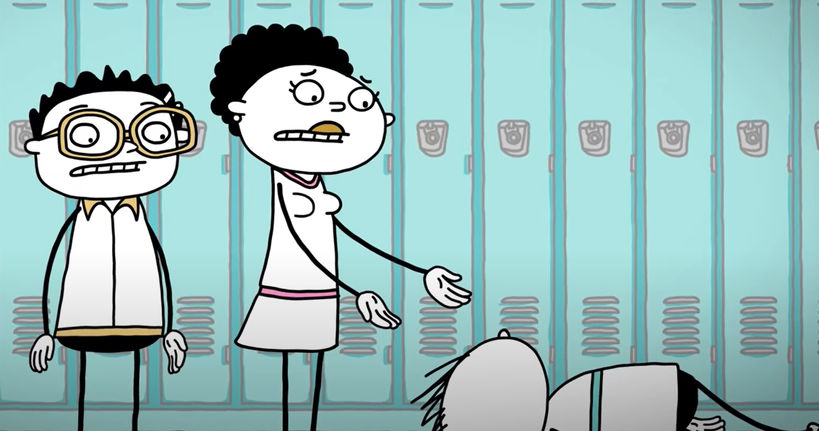
What is sexual exploitation and sex trafficking?
Let’s watch the video
“Sex Trafficking: What is it?”
by AMAZE org
Notes:
As they watch this video, students can note the risk factors that can make people vulnerable to sex traffickers and recall their notes and discussion from Activity 1.

Slide 6
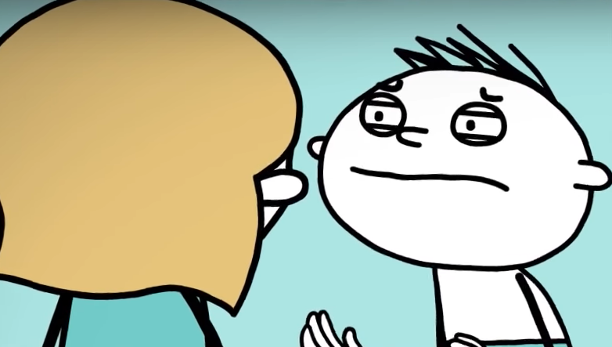
What is sexual exploitation and sex trafficking?
Child sexual exploitation and Sex Trafficking refers to situations where youth (under the age of 18) are forced to exchange sexual acts or images for material items such as food, shelter, drugs, clothing and/or non-material items such as protection, love, and belonging, through the use of power, control, and manipulation.
Child sexual exploitation includes all child pornography offences, age of consent offences as well as prostitution under the age of 18.
Notes:
The following slides, will provide the answers to the questions on slide 6. Unpacking these answers with all students will allow them to fill out the exit card at the end of this lesson.
Handout exit ticket or prepare a digital version of the Exit Ticket. This document could be completed separately by students through Google Forms or simultaneously as a class using a Digital White Board. Instructions on how to use these digital tools are found below.
Here is an example of a google form version of the exit card. You can easily create one on google forms. https://docs.google.com/forms/d/e/1FAIpQLSd2haASY5JglQqTdAMvMvr0k6EOCd3tk_Pt2RuU1XmFOTr9ow/viewform?usp=sf_link
https://docs.google.com/forms/d/e/1FAIpQLSd2haASY5JglQqTdAMvMvr0k6EOCd3tk_Pt2RuU1XmFOTr9ow/viewform?usp=sf_link
Online Delivery Guide: Google forms
A google form is an excellent way to allow for students to respond in their own words to show that they understand the content that has been discussed. To create your own form:
Go to forms.google.com
Click Blank +
A new form will open
Edit your form by adding questions
Choose where to save form responses
Send your form to your students

Slide 7
Where does it happen?
Sex-trafficking is a growing problem in Canada and has been on the rise since 2010.
Between 2009 and 2016, 2 of 3 reported sex-trafficking crimes in Canada occurred in Ontario.

Slide 8
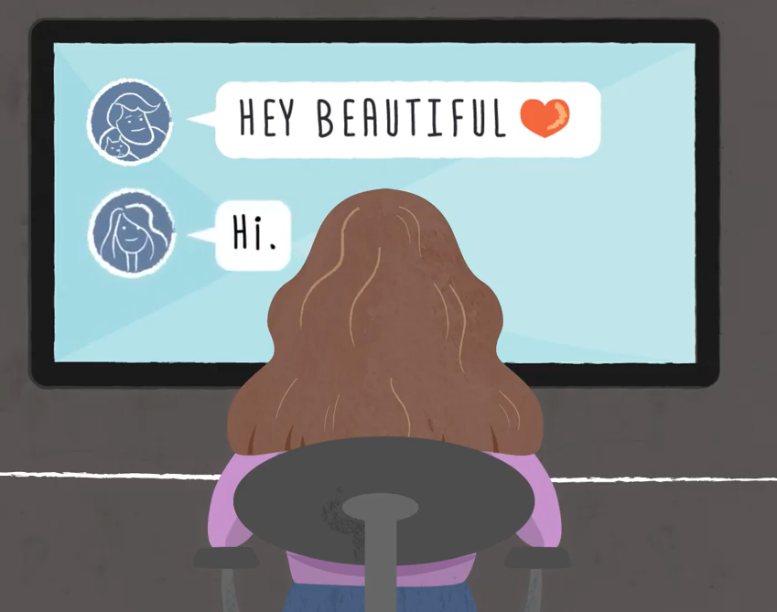
Where does it happen?
Sexual exploitation and trafficking can happen anywhere. Youth are often targeted close to their schools, at malls, and even at home.
In recent years, traffickers have started to significantly target youth through popular social media apps including Instagram, TikTok, Facebook, as well as dating apps. The COVID-19 pandemic made online sexual exploitation more prevalent than ever.

Slide 9
Who is at risk?
While anyone is at risk, the most vulnerable are:
Women and girls under the age of 25
Indigenous women and girls
Members of the 2SLGBTQ+ community
Other marginalized groups (groups with little or limited power in society)

Slide 10
Who can be a perpetrator?
Sex-traffickers can be anyone including peers, relatives, friends, domestic partners, gang members, internet predators, etc.
Always trust your gut!!
But…
most tend to be young males and
women and girls may be controlled and exploited by perpetrators to help find and prepare victims.

Slide 11
What have you learned?
What is sex trafficking?
Where does it happen?
Who is at risk of being targeted for child sexual exploitation and sex trafficking?
Who can be a perpetrator?
What questions remain?
Notes:
Students should be given time to add/ make changes to their exit card prior to submitting.

Slide 12
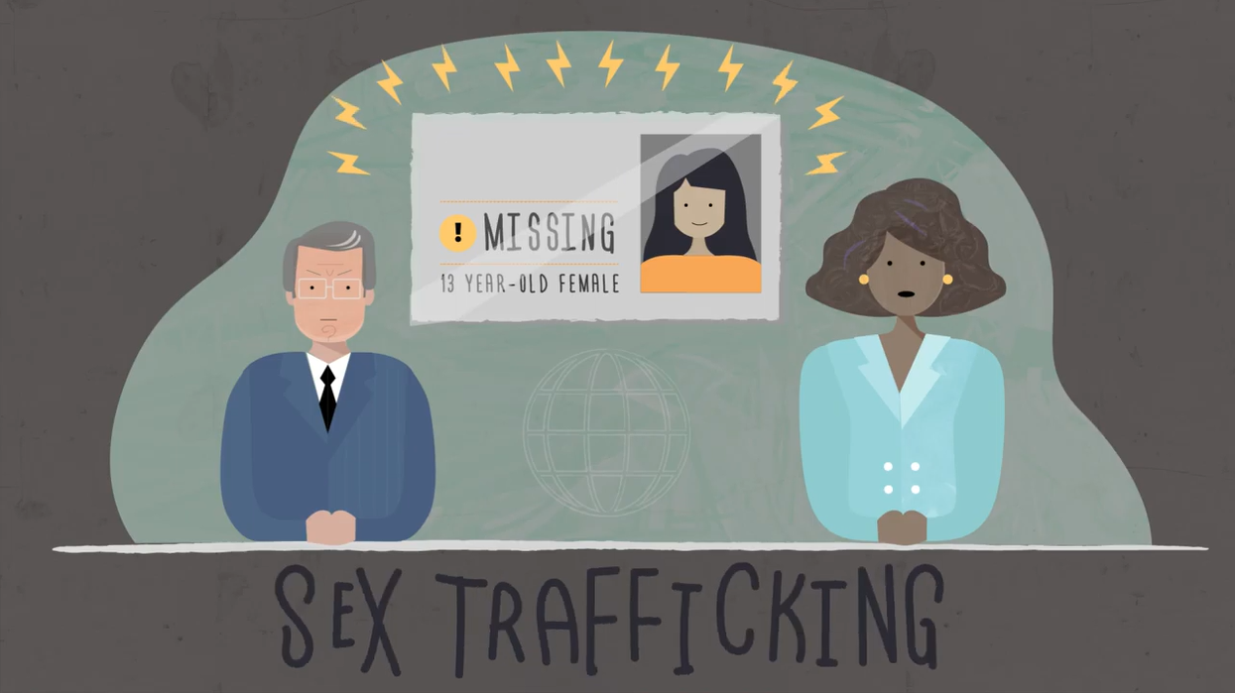
What is sexual exploitation and sex trafficking?
Let’s watch the video
“What is Sex Trafficking?”
by activist Rhonelle Bruder
Notes:
Activity Two
In order to emphasize the fact that anyone can become a victim of sexual exploitation and sex trafficking, show a video or read an article featuring a survivor’s story. The YouTube video “What is Sex Trafficking?” from the youtube channel RealRhonelle created by Rhonelle Bruder.
As a class, have students reflect on the video:
What about it surprised them?
Have they heard similar stories before?
What risk factors can make people vulnerable to sex traffickers?
Reflection can be done using the following online tools:
Suggested digital tool online:
Zoom -whiteboard room https://zoom.us
Google meet- Jamboard https://meet.google.com
This whole class activity provides students with the opportunity to reflect and refine their thinking on a topic as a large group. interactive whiteboards allow students to share their ideas without occupying the same physical space. Keep the following in mind when using whiteboards/jamboards:
Provide the class with clear directions for each slide
Decide if you want students to out their names after their answers
Keep your answers appropriate for the class setting, be mindful of the potential experience of others.

Slide 13
Something for you to think about…
Think about the apps, social media platforms, and other digital environments on which you tend to spend most of your time.
How safe do you think these platforms are?
Notes:
The second half of this activity focuses on online safety. Begin by asking students why sex traffickers might prefer the internet to approach their victims. The discussion should focus on how youth tend to be less cautious online and thus an easier target for traffickers.
Ask students to help you create a list on the whiteboard/Jamboard of all of the online spaces where students might encounter a sex trafficker. Some answers may include:
Instagram
Snapchat
YouTube
TikTok
Facebook
Dating/ “find friends” apps
Online gaming chat/other message boards/apps
Suggested digital tool online:
Zoom -whiteboard room https://zoom.us
Google meet- Jamboard https://meet.google.com
This whole class activity provides students with the opportunity to reflect and refine their thinking on a topic as a large group. interactive whiteboards allow students to share their ideas without occupying the same physical space. Keep the following in mind when using whiteboards/jamboards:
Provide the class with clear directions for each slide
Decide if you want students to out their names after their answers
Keep your answers appropriate for the class setting, be mindful of the potential experience of others.

Slide 14
What apps might be used by sex traffickers to target their victims?
Indicate what you think and add other online spaces not on the list:
Instagram
Snapchat
YouTube
TikTok
Facebook
Dating/ “find friends” apps
Online gaming chat/other message boards/apps
Any other online spaces?
Notes:
Students can use a Stamp annotation tool or the chat box to indicate their initial thoughts. Then update this list of online spaces where students might encounter a sex trafficker using a digital White Board.

Slide 15
What we will be working towards…
Create a checklist of safety tips that will help you stay protected, as best as you can, from online sex traffickers.

Slide 16
Preventing Sex Trafficking: Online Safety Tips
Online Safety Tip | Explanation
Disable geotagging on your phone
Set strict privacy settings on social media
Think before you post
Use generic usernames
Message/chat with people you know in person
Watch out for overly friendly or complimentary followers/comments
Always let your friends and family know when and where you are meeting new people
As a class, let's discuss each of the tips and fill in the “explanation” boxes of the chart.
Notes:
Hand out the student copy of “Preventing Sexual exploitation and Sex Trafficking: Online Safety Tips”. Have students work individually to complete 2 of the tips and to consider another that is not included on the list. Students will become “experts” in their areas of focus and will then be able to share their ideas back to the larger group. (i.e. One set of students can focus on “Disable geotagging on your phone” and “Set strict privacy settings on social media” as well as their own tip, which they can fill in using the blank boxes below, Another set of students can work on “Think before you post” and “Use generic usernames” as well as their own tip, etc...) Once students have had the opportunity to work on their assigned questions individually, come back as a larger group to discuss all of the tips, making sure that students have the opportunity to complete the form in its entirety.
Refer to the notes in the “Preventing Sex Trafficking: Online Safety Tips. Resource for Educators” at the end of this powerpoint presentation. Focus on how each of the tips in the left column promotes online safety.
A digital white board can be used for the delivery of this activity (instructions below). Teachers complete the column on the right based on the class discussion and the notes in the Teacher Copy.
This activity can also be delivered following an individual google doc format.
Online Delivery Guide: White Board
Digital White Boards are available on Zoom (White Board feature), MIcrosoft Teams (Microsoft WhiteBoard feature), Google Meets (Jamboard feature).
You can also use Google Jamboards (https://jamboard.google.com/) to create a white board. By clicking on the “Share” button can change privacy settings and invite students through e-mail or by sharing a link to collaborate in the same document.

Slide 17
Let’s Practise
How to…
Change privacy settings in different social media platforms
Disable geotagging in different social media platforms
Other safety features?
Notes:
Practice these safety tips with your students so they become familiar with ways to change privacy settings, disable geotagging etc. Students may know how to make these changes and can share this information with the class.
Online Delivery Guide: Screen Capture Demonstration
Suggested digital tool:
Veed https://www.veed.io
Screencapture https://www.screencapture.com
Demonstrations are an effective way for teachers to provide students with specific procedural instructions. Digital instructions are most effective when recorded, providing students with a way to review and revise specific steps in a task. When demonstrating actions in a digital sphere, it is helpful for teachers to use screen capture demonstrations. The following suggestions should prove beneficial:
After familiarizing yourself with the screen capture software, clear your desktop and browser tabs of all unnecessary files or links. This will help students focus on the task at hands.
Identify the most efficient way to perform the action you wish to demonstrate.
Write down a step by step guide of each action to be performed.
Prepare a script of instructions to accompany your demonstration.
Practice the procedure you wish to demonstrate before recording.
After reviewing your recording, upload the file to a video repository that students can access. Make sure to set the appropriate permissions (eg. Full public access or class only access).

Slide 18
Time to reflect?
Are you doing enough to keep yourself safe online?
Answer this anonymous Poll:
Absolutely
I try, but I’m not sure.
I don’t think about it.
Notes:
This discussion, based on a Poll, serves as a ‘wrap-up’’ activity to engage students as you close this activity
There are many myths surrounding sex trafficking. Teachers will need to gauge the level of knowledge/awareness of their students and decide if they need to spend more time on certain areas of the lesson than others. Review the “Preventing Sex Trafficking: Online Safety Tips – Teacher Copy” to become more familiar with online safety strategies.
Digital Delivery Guide: Online Polls
Suggested digital tool:
Mentimeter https://www.mentimeter.com
Kahoot https://kahoot.com/
Poll function in your online learning system
Inviting student feedback is a helpful diagnostic tool that can help prompt discussion. There are numerous online polling platforms to choose from. When dealing with sensitive topics, ensure that submissions are anonymous and easily accessible (eg. they do not need registration). The following suggestions should inform your polling:
Familiarize yourself with the setting functions of the platform.
Select the appropriate poll to allow a student to provide original comments.
Adjust the settings as required (eg. You may wish to adjust the number of responses per student.)
Create the quiz prior to the lesson using the question prompts.
When conducting the poll, use the sharing function to display the poll results to students.

Slide 19
Online Safety Infographic
Create an infographic that educates other teens on how to stay safe online from sex-traffickers. Infographics should include specific safety tips as well as a list of community resources that teens can access if they or someone else they know becomes a victim of sex-trafficking. Infographics will be posted in our classroom and around the school.
Notes:
Activity 3
Depending on class time available, teachers can engage students in the creation of this infographic, an engaging extension activity. There are many online resources to assist in the creation of infographics. Canva is one such resource. Students can post their infographics in a shared online space for the class. Infographics can also be posted in the classroom and around the school.
Help students to understand that part of learning involves action and activism. Start by sharing with students that activism and action means that once we learn, we speak up when we see injustices and when we understand that harmful and hurtful things are happening in the world around us. Explain to students that this learning is to hopefully prevent this from happening to other people. Now that we have learned, we need to act. Let students know that our actions can take many forms and today we will be creating a media text that can be shared with others. Indenpendently, have students create a media text (infographic, poster, video, song performance, etc.) that educates other children and teens on how to stay safe online from sex-traffickers. The media texts should include specific safety tips. Students who are interested in finding out more about community resources can research and include their information in their media texts. These resources can be extremely helpful for children and teens to access if they or someone else they know becomes a victim of sex-trafficking.
Online Delivery Guide: Infographic.
Suggested digital tool:
Google Apps for Education - (Drawings, Slides - SlidesMania or Slides Carnival)
Adobe Spark
Chrome Music Lab (if they choose to care their own song)
Prezi
Powtoon
Infographics are concise visual representations of student understanding. The use of digital infographic creators allows students of all artistic abilities to create compelling visual displays. Use the following suggestions to help students in their creation of an infographic.
Review the principles of effective infographics, such as effective layout and informative display of data.
Ask students to select the most important information and data for use in their infographic.
Have students decide the best method for displaying the information (pie, line or stacked graph) and select an appropriate theme for the display (colour range, imagery etc.).
Have students create a compelling title for their infographic that would grab the attention of their intended audience.

Slide 20
Let’s Discuss
What is the purpose of an infographic?
What are the specific design features of great infographics?
What tools might you use to create an infographic?
Notes:
Teachers can show students one or two infographics and discuss the purpose and design features of these infographics and the extent to which they would consider the samples to be good infographics.
Criteria for excellent infographics can include the following (students can add to the list):
One clear and coherent message or idea
Clear communication (easy to navigate/view/understand)
Simple combination of colours (maximum of 3)
Uses 2-3 quality fonts
Suitable spacing (not too crowded)
Relevant information but not too much

Slide 21
Let’s Share our Infographics
Share your infographics with the class.
Where would it be helpful to other students to post these around our school?
Notes:
Allow students to share their infographics with their classmates. Discuss where it would be helpful to post these infographics in the school to help educate other students about online safety tips in relation to preventing sex trafficking.
An alternative approach would be to share the infographics in an online space, have students peer assess them using agreed upon criteria and then post them in the classroom and around the school.

Slide 22
Extension: Community partners
Have students connect with one of the community partners to see what they might do beyond this learning within the community.
Students can also create announcements and/or display their media texts throughout the school to bring awareness to other classrooms and students.
Notes:
Activity 3: Extension
Depending on class time available, teachers can engage students in reaching out to community partners, an engaging extension activity.

Slide 23
I pledge never to commit, condone, or remain silent about violence against women and girls
Take the pledge online: whiteribbon.ca/pledge
Learn more about White Ribbon at:
whiteribbon.ca
@whiteribboncampaign
@whiteribbon
@whiteribboncanada

Slide 24
Resources for Educators
Notes:
“Preventing Sex Trafficking: Online Safety Tips” guide for educators as mentioned in activity 3.

Slide 25
Online Safety Tip | Explanation
Disable geotagging on your phone | Geo-tagging attaches geographical locations to posts, allowing followers to see exactly where the person was when they made the post. Sex traffickers may use this information to locate victims. They may also use this information as a way to initiate conversation/create a false familiarity with victims. For example, the sex trafficker may claim that they saw the poster at the geo-tagged location and that they looked beautiful.
Set strict privacy settings on social media | Only allow your friends/followers to view your pictures and posts. Only accept friends/followers that you know in person.
Think before you post | Be careful not to include identifying information in your posts, including phone numbers, where you live/work, etc.
Use generic usernames | Make sure your username does not reveal personal information about yourself (e.g. your full name or birthday)
Message/chat with people you know in person | Keep messages private and with people you know. If you are messaging with someone new, do not reveal any personal information about yourself (first and last name, birthday, where you live, etc.).
Watch out for overly friendly or complimentary followers/comments | Online sex traffickers often try to establish friendships/relationships with their victims. Be wary of anyone you don’t know who is commenting in an overly friendly or loving way.
Always let your friends and family know when and where you are meeting new people App suggestion: Find My Friends | There are different apps that youth can use to share their live location with their friends and family members to let them know where they are and that they are safe. Find My Friends is available for IOS and Android Devices for free .
Preventing Sex Trafficking: Online Safety Tips. Resource for Educators
Notes:
“Preventing Sex Trafficking: Online Safety Tips” guide for educators as mentioned in activity 3.

