Slide 1
Ending Rape Culture and Child Sexual Exploitation Together
Course: -----------
Notes:
Learning Objectives:
●Define and create awareness about the impact of Rape Culture
● Foster empathy with women and 2SLGBTQ+ people
● Discuss actions students, including male-identified individuals, can do to end Rape Culture
Notes for Educators:
Rape Culture refers to the normalization of sexual violence through cultural narratives influencing all levels of social interaction. Rape culture can manifest as jokes, comments, TV shows, music, workplace interactions, and policy and law, among others. Consequently, male sexual aggression, sexualized violence and harassment against women and the LGBTQ2S+ community, and re-victimization and victim-blaming are presented as inevitable and normal events.
As direct effects of Rape Culture, survivors are not believed, experience victim-blaming, public shaming and social stigmatization. In addition, perpetrators are not held accountable, their aggressive behaviour remains unchallenged, and sexualized violence is considered part of the status quo.
Similarly, Rape Culture makes bystanders less likely to intervene as they will not identify sexual violence as a problem but rather as regular behaviour.
Online Delivery Guide:
Throughout this powerpoint presentation you will find suggested digital tools and platforms for activity implementation in online spaces.
Optional Activities:
This lesson plan was shortened from its original version. Some of its activities were included as “Optional Activities” at the end of this presentation.
Teacher Supervision:
Online technology allows students to engage meaningfully with both course material and their peers. Due to the sensitive nature of the content, be cognizant of the potential for triggering interactions. Your chosen digital toolset should reflect the maturity and sensitivity of your students. For example, you may prefer classroom discussions as they allow for monitoring of discussion if you have concerns about small group interactions without adult supervision.
Accessing Support Material:
Support material is located throughout the accompanying slide decks. Teachers wishing to make use of them are encouraged to download version(s) to their desktop for distribution to students where applicable. Teachers using learning management systems should upload a version of files for students wishing to work asynchronously. Note that all lessons, with the embedded student materials, are available for downloading as both PDF and Word documents on the wrprevent.ca website.
Digital Delivery Guide: Word Wall
Suggested digital tool:
Padlet http://padlet.com/
Google Doc https://www.google.com/docs/about/
Zoho Docs https://www.zoho.com/docs/
Word walls help students retain new vocabulary. Accessibility is the key to an effective word wall. Students need to be able to refer back to the definitions with ease. A digital word wall creates an online repository of ideas and concepts. Use the following suggestions when creating a digital word wall.
Choose a platform that allows collaborative editing.
Invite students to the Digital word wall
Curriculum Connections:
Civics and Citizenship Gr 10 (CHV2O):
B1.1 describe some civic issues of local, national, and/or global significance
B3.5 identify examples of human rights violations around the world
Politics in Action: Making Change Gr 11 (CPC30):
B1.1 Identify some agents of political socialization (e.g., the family, public education, religious institu-tions, the media, peers, personal experience, political/social organizations), and analyse how these agents affect their own personal political beliefs and engagement and the beliefs and engagement of others
B3.2 Analyse the impact of some issues of political importance, with a particular emphasis on issues related to equity, human rights, and/or the environment (e.g., homelessness, child poverty, growing economic inequality, foreign aid, free speech, accessibility issues, refugee crises, discrimination against girls and women in many countries, urban sprawl, carbon emissions, climate change, protection of water)
Healthy Active Living Education Gr.12 (PLL4O):
C3.4 analyse the portrayal of different relationships in the media with respect to bias and stereotyping, and describe how individuals can take action to encourage more realistic and inclusive messaging

Slide 2
In-school resources:
Canada-Wide Resources:
Canadian Human Trafficking Hotline
canadianhumantraffickinghotline.ca
ENG/FR - Online chat available
Hope for Wellness Helpline
hopeforwellness.ca
Offers immediate help to all Indigenous peoples across Canada. ENG/FR - Online chat available
Content Warning
and Support
Let’s create a class agreement!
Notes:
Content Warning:
For many students this might be their first time discussing sexual exploitaiton and sex trafficking
Remind students that they’ll be discussing a difficult topic and assure them that number one priority throughout the sessions is their well-being.
Remind students that support is available. They can either access school support (social workers, councillors, etc.) or Canada wide resources.
Students should be informed about the presentation content and given the option to not participate in the lesson
Create a class agreement: Ask students share what considerations should be kept in mind to make everyone feel safe (e.g. being respectful towards everyone’s opinions and using respectful language, not joking about sensitive topics, being mindful of how much space we take throughout the session)
Complete this slide with school supports (social workers, counsellors, etc.) available for survivors and/or those who want to make any disclosures, nationwide resources and online information (such as the wrprevent.ca website) can also be made available to students
Creating a class agreement:
It is essential to create a class climate suitable for the seriousness of the topic. Ask students to share what considerations should be kept in mind to make everyone feel safe (e.g. being respectful towards everyone’s opinions and using respectful language, not joking about sensitive topics, being mindful of how much space we take throughout the session, etc.)

Slide 3
Something for you to think about…
How can we challenge Rape Culture and build consensual and healthy relationships?
Notes:
Activity 1:
Slides 3-5 will help you prepare your students for the lesson plan. Students should be given this question at the start of the lesson so that their experiences throughout the next activities are aligned with this targeted learning.

Slide 4
What we will be working towards…
Choose one powerful action you can take to help put an end to Rape Culture and build a culture of consent and healthy relationships.
Write a sentence stating your commitment to this action. Include a goal for how many times you will take this action and track the number until you meet your goal.
Notes:
Let students know that they will respond to this task at the end of the lesson.

Slide 5
What is your initial thinking?
“Consent is the key to ending Rape Culture and building healthy relationships.”
To what extent do you believe this statement to be true?
Answer the following Poll anonymously:
Absolutely
Somewhat true
Not sure
I don’t think so
Notes:
Note that we will come back to this slide at the end of the lesson (See slide 22) to see the extent to which student thinking has shifted as a result of the lesson.

Slide 6
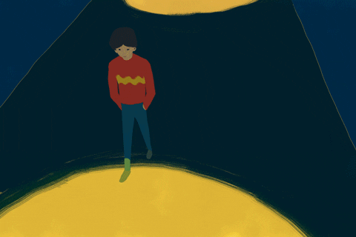
Your Thinking
Individually, write down a list of things you would have to do to go for a walk at night as safely as possible.
Notes:
Activity 2:
This activity is meant to engage students in critical thinking regarding their own social positioning, privilege and disempowerment.

Slide 7
Share your thinking
How do these ideas compare to the ones on your list?
Be with a group of people I know
Walk in highly lit areas
Being on guard at all time
Walk with purpose and not stop
Carry something to defend myself with
Be prepared with an emergency plan
Change/hide my body language and/or clothing
What other ideas could you add? Share with the class.
Notes:
It is important to keep in mind that public areas are not equally safe for everyone. Verbal and physical abuse are often faced by women and 2SLGBTQ+ identifying folks.
Because of this reason, they might take some precautions that men do not have to take. From preparing emergency plans, to “masculinizing” their way of walking or expressing, folks are forced to adopt different strategies to remain safe in the streets.
The instagram account @catcallsofnyc (instagram.com/catcallsofnyc/) is a great example of community based activism creating awareness and looking to end street harassment.

Slide 8
Let’s Discuss
Why is this list usually longer for female-identified and 2SLGBTQ+ identifying individuals?
What are some examples of violence and harassment that people can face in the street? How do they affect different genders?
Why are female-identified people as well as 2SLGBTQ+ individuals more likely to be harassed in public spaces?
Why do you think street harassment and violence happen?
Notes:
Address these questions and student comments in a whole-class discussion.
The instagram account @catcallsofnyc (instagram.com/catcallsofnyc/) is a great example of community based activism creating awareness and looking to end street harassment.

Slide 9
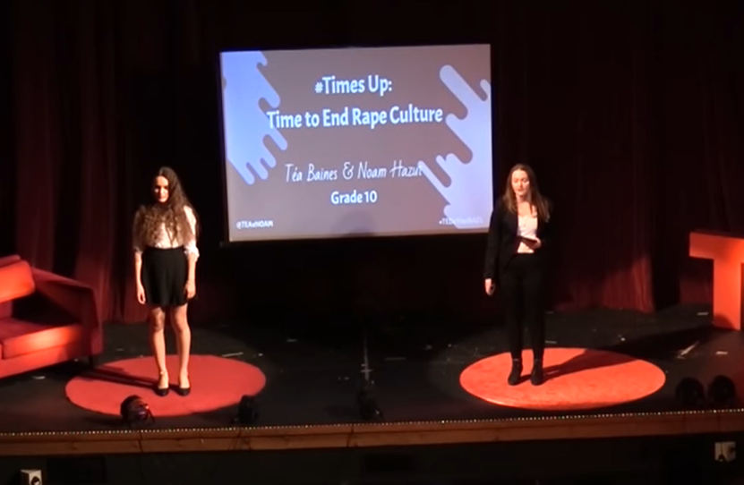
Let’s Deepen Our Thinking
Watch the video Time's Up: Let's End Rape Culture by Téa Baines and Noam Hazut and answer the following questions.
Notes:
Activity 3:
Educators should watch this video before the delivery of this lesson and warn students about explicit language and triggering content.

Slide 10
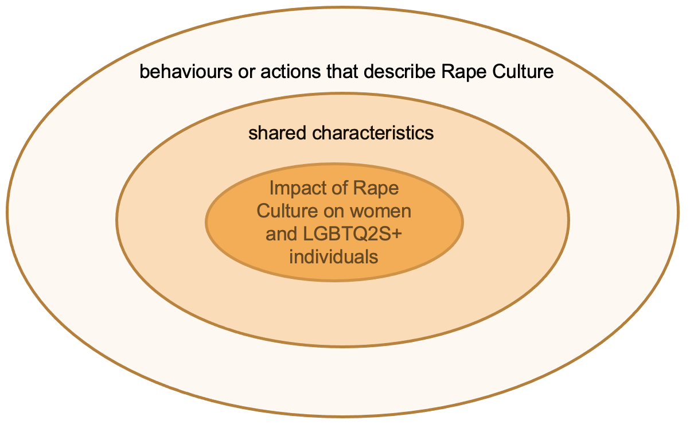
Let’s Deepen Our Thinking
Place your ideas in the appropriate area of the online class circle diagram.
What are some examples of Rape Culture? That is, what are some behaviours or actions that describe Rape Culture?
What are some shared characteristics of these examples, behaviours and actions?
What is the impact of Rape Culture on women and 2SLGBTQ+ individuals?
Notes:
Discuss the answers to these questions and discuss how individuals who participate in or subscribe to rape culture are enabling sexual violence with their actions. Note that the “Notes for Educators” at the beginning of the lesson has a thorough definition of Rape Culture.

Slide 11
Clarifying Terms
What is your understanding of the following terms?
-Rape Culture
-Consent
-Consent Culture
Notes:
See the “Notes for Educators” at the beginning of the lesson for additional information pertaining to this definition. Add the term Rape Culture and its definition to the digital Word Wall.
Digital Delivery Guide: Word Wall
Word walls help students retain new vocabulary. You might consider creating a digital word wall with the new vocabulary words covered in this session
Suggested digital tool:
Padlet http://padlet.com/
Google Doc https://www.google.com/docs/about/
Zoho Docs https://www.zoho.com/docs/
Accessibility is the key to an effective word wall. Students need to be able to refer back to the definitions with ease. A digital word wall creates an online repository of ideas and concepts. Use the following suggestions when creating a digital world wall.
Choose a platform that allows collaborative editing.
Invite students to the Digital word wall

Slide 12
Clarifying Terms
Rape Culture – when people act, think, represent and accept sexual assault and sexual violence as a normal way of life. For example, through jokes, comments, media, workplace interactions, law, etc.
This leads to sexual violence and harassment against women and the 2SLGBTQ+ community, where victims become victims over and over again, and are blamed for it.

Slide 13
Clarifying Terms
Consent: Voluntarily agreeing to participate or do something.
Consent must always be F.R.I.E.S.
Freely Given: No one can be coerced into consenting
Reversible: Consent can be withdrawn at any time and should be respected
Informed: You must clearly know what you are consenting to do
Enthusiastic: If you or the other person are hesitant about it, it’s better to just leave it to another time
Specific: Each act requires consent each time, even if you've done it before.

Slide 14
Clarifying Terms
Consent culture
A culture where consent is normalized and
sexual violence constantly challenged

Slide 15
Let’s Deepen Our Thinking
As a class let’s address one of the following questions
Notes:
Activity 3:

Slide 16
Let’s Deepen Our Thinking –
How might women and LGBTQ2S+ individuals feel when faced with Rape Culture behaviours and actions?
How might Rape Culture impact your relationships with others?
In an inclusive and equitable world, how will women and LGBTQ2S+ individuals feel when:
Walking alone in the streets?
Consuming media?
Being in a relationship?
Sharing experiences of sexual violence?
Notes:
Find below possible answers to these questions. This entire section should focus on building empathy towards those negatively impacted by Rape Culture and Child Sexual Exploitation. By focusing on how women and the LGBTQ2S+ are affected, stress the role students play in challenging Rape Culture.
Teachers can use a digital white board to capture class discussion.
ANSWERS
1. How might women and 2SLGBTQ+ individuals feel when faced with Rape Culture behaviours and actions?
Answer: Like victims, not valued because experiences of violence are dismissed, ignored or portrayed as normal the continuous in video clips, music, etc.
2. How might Rape Culture impact your relationships with others?
Answer: It harms relationships; makes one person feel disrespected and not valued; could lead to mental health issues, etc.
3. In an inclusive and equitable world, how will women and LGBTQ2S+ individuals feel when:
Walking alone. Answer: safe and not scared
Consuming media. Answer: like a human being not an object that is owned or controlled, inspired by healthy images of themselves on the media
In a relationship. Answer: respected, valued for who they are, not compared
Sharing experiences of sexual violence. Answer: believed, heard, respected, with a voice to decide what happens next

Slide 17
Let’s Deepen Our Thinking –
What feelings or attitudes may contribute to men harassing women in public spaces/street?
Are those attitudes learned? Where are they learned?
How do these attitudes affect men?
What can men do to challenge these behaviours and end rape culture?
Notes:
Use this section to discuss male-allyship, the role of male-identifying students play in challenging Rape Culture and how doing this can ultimately affect their communities and own lives positively.
ANSWERS:
1.What feelings or attitudes may contribute to men harassing women in public spaces/street?
Answer: Believing that intimidation is normal and expected, not trying to understand the views of others; needing to appear “cool” in front of friends, belief that women are expected to be sexual and that men can’t control their sexual needs.
2. Are those attitudes learned? Where are they learned?
Answer: learned from the media, family, friends, people who hold power
3.How do these attitudes affect men?
Answers: negatively impact on relationships (they might hurt people they respect and love), their mental health might suffer, they might measure their value based on traditional and unhealthy expectations of what it means to be a man.
4. What can men do to challenge these behaviours and end Rape Culture?
Answer: take responsibility for these actions and behaviors, work hard to have healthy and meaningful relationships, show
respect to women and LGBTQ2S+ individuals, honour and
protect consent in relationships.

Slide 18
Let’s make a change
How can we challenge Rape Culture and build consensual and healthy relationships?

Slide 19
What is your thinking now?
“Consent is the key to ending Rape Culture and building healthy relationships.”
To what extent do you believe this statement to be true?
Answer the following Poll anonymously:
Absolutely
Somewhat true
Not sure
I don’t think so

Slide 20
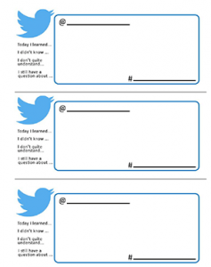
What is your thinking now?
“Consent is a key element for building healthy relationships. While men play an important role in addressing Rape Culture, there is always something we can all do to achieve gender equity and inclusion.”
Exit Ticket:
List three important things you learned about
consent from this lesson.
Notes:
Collect the Exit Ticket from the students and then discuss the topic of consent and the important role everyone can play to achieve gender equity and inclusion.
Use some time at the end of the session to highlight the importance of consent as a key element for building healthy relationships as well as the role that men can take in addressing Rape Culture. From media consumption to the language individuals use, there is always something we can all do to promote the rights of survivors, challenge victim-blaming, demand media representation of consensual and healthy relationships, and achieve gender equity and inclusiveness.

Slide 21
Be empowered to make a change!
Choose one powerful action you can take to help put an end to Rape Culture and replace it with the building of consensual and healthy relationships. Write a sentence stating your commitment to this action. Include a goal for how many times you will take this action and track the number until you meet your goal.

Slide 22
I pledge never to commit, condone, or remain silent about gender-based violence
Take the pledge online: whiteribbon.ca/pledge
Learn more about White Ribbon at:
whiteribbon.ca
@whiteribboncampaign
@whiteribbon
@whiteribboncanada

