Slide 1
Creating Healthier Masculinities
Course: -----------
Notes:
Learning Objectives:
● Unpacking stereotypical expectations on masculinity and how they enable different types of violence including child sexual exploitation and sex trafficking
● Discussing alternatives to unhealthy expectations in masculinity and assessing their impact
Notes for Educators:
This lesson plan focuses entirely on social norms associated with masculinity. It can be done either with an exclusively male-identifying youth as well as with students of all genders. If sessions are divided by gender identity, non-binary and trans students should be given the opportunity to join the session that is the most affirming for them.
Please note that throughout this lesson plan, it’s important to use a strength based-lens in which conversations are not framed as a critique on masculinity but rather as opportunities to find alternatives to the unhealthy behaviour that is embedded in our culture and expected from maleidentified individuals.
Online Delivery Guide:
Throughout this powerpoint presentation you will find suggested digital tools and platforms for activity implementation in online spaces.
Optional Activities:
This lesson plan was shortened from its original version. Some of its activities were included as “Optional Activities” at the end of this presentation.
Teacher Supervision:
Online technology allows students to engage meaningfully with both course material and their peers. Due to the sensitive nature of the content, be cognizant of the potential for triggering interactions. Your chosen digital toolset should reflect the maturity and sensitivity of your students. For example, you may prefer classroom discussions as they allow for monitoring of discussion if you have concerns about small group interactions without adult supervision.
Accessing Support Material:
Support material is located throughout the accompanying slide decks. Teachers wishing to make use of them are encouraged to download version(s) to their desktop for distribution to students where applicable. Teachers using learning management systems should upload a version of files for students wishing to work asynchronously. Note that all lessons, with the embedded student materials, are available for downloading as both PDF and Word documents on the wrprevent.ca website.
Curriculum Connections:
Gender Studies Gr.11 (HSG3M):
B2.1 Analyse the ways in which power and privilege are unequally distributed between and among males and females in homes, schools, workplaces, and community settings
B2.3 Analyse ways in which sexism can manifest itself in contemporary Canadian society
Dynamics of Human Relationships Gr. 11 HD3O):
C1.1 Describe various types of relationships that people may experience during their lifetime explain the contributions healthy relationships make to individual, group, family, and community well-being
C2.1 Analyse ways in which social and cultural factors, including portrayals in the media, shape people’s ideas about relationships
Healthy Active Living Education Gr. 9 (PPL1O):
C1.5 Demonstrate an understanding of factorse.g., acceptance, stigma, culture, religion, media, stereotypes, homophobia, self-image, self-awareness) that can influence a person’s understanding of their gender identity (e.g., male, female, two-spirited, transgender, transsexual, intersex) and sexual orientation (e.g., heterosexual, gay, lesbian, bisexual), and identify sources of support for all students

Slide 2
In-school resources:
Canada-Wide Resources:
Canadian Human Trafficking Hotline
canadianhumantraffickinghotline.ca
ENG/FR - Online chat available
Hope for Wellness Helpline
hopeforwellness.ca
Offers immediate help to all Indigenous peoples across Canada. ENG/FR - Online chat available
Content Warning
and Support
Let’s create a class agreement!
Notes:
Content Warning:
For many students this might be their first time discussing sexual exploitaiton and sex trafficking
Remind students that they’ll be discussing a difficult topic and assure them that number one priority throughout the sessions is their well-being.
Remind students that support is available. They can either access school support (social workers, councillors, etc.) or Canada wide resources.
Students should be informed about the presentation content and given the option to not participate in the lesson
Create a class agreement: Ask students to share what considerations should be kept in mind to make everyone feel safe (e.g. being respectful towards everyone’s opinions and using respectful language, not joking about sensitive topics, being mindful of how much space we take throughout the session)
Complete this slide with school supports (social workers, counsellors, etc.) available for survivors and/or those who want to make any disclosures, nationwide resources and online information (such as the wrprevent.ca website) can also be made available to students
Creating a class agreement:
It is essential to create a class climate suitable for the seriousness of the topic. Ask students to share what considerations should be kept in mind to make everyone feel safe (e.g. being respectful towards everyone’s opinions and using respectful language, not joking about sensitive topics, being mindful of how much space we take throughout the session, etc.)

Slide 3
Something for you to think about…
How can we challenge unhealthy expectations of masculinity and build healthy relationships between people of various gender identities?
Notes:
Activity 1:
Slides 3-5 will help you prepare your students for the lesson plan.
Ask Students to keep this question in mind throughout this lesson plan.

Slide 4
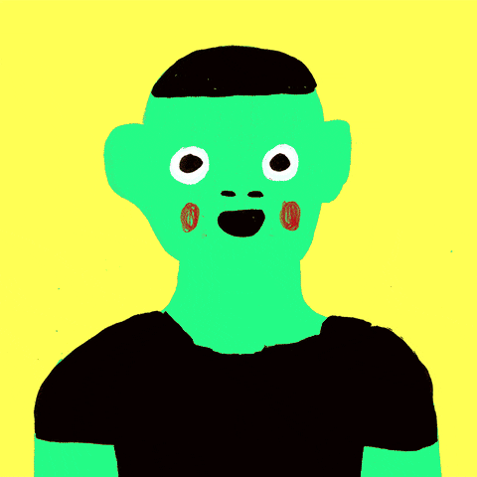
What we will be working towards…
Create a social media post representing a healthy portrayal of masculinity. Share this depiction on social media to increase awareness and help young people overcome these stereotypes.
Notes:
This will be the task for the end of the lesson plan. Educators can assess possibilities to share the assets created by students through the school’s social media channels in order to further motivate students.

Slide 5
What is your initial thinking?
To what degree do you think the stereotype of traditional masculinity leads to:
Place an X on each line to show your response.
Women being treated like objects? Low High Degree | Homophobia (a dislike or prejudice against homosexual people)? Low High Degree
Control over emotions? Low High Degree | Violence against girls, women and members of the 2SLGBTQ+ community? Low High Degree
Notes:
We will come back to this slide at the end of the lesson to see the extent to which student thinking has shifted as a result of the lesson.
Educators can use the Stamp Annotation tool available on Zoom or similar tools in other platforms to run this activity. Alternatively, questions can also be adapted to a digital poll.
Digital Delivery Guide: Online Polls
Suggested digital tool:
Mentimeter https://www.mentimeter.com
Kahoot https://kahoot.com/
Poll function in your online learning system
Inviting student feedback is a helpful diagnostic tool that can help prompt discussion. There are numerous online polling platforms to choose from. When dealing with sensitive topics, ensure that submissions are anonymous and easily accessible (eg. they do not need registration). The following suggestions should inform your polling:
Familiarize yourself with the setting functions of the platform.
Select the appropriate poll to allow a student to provide original comments.
Adjust the settings as required (eg. You may wish to adjust the number of responses per student.)
Create the quiz prior to the lesson using the question prompts.
When conducting the poll, use the sharing function to display the poll results to students.

Slide 6
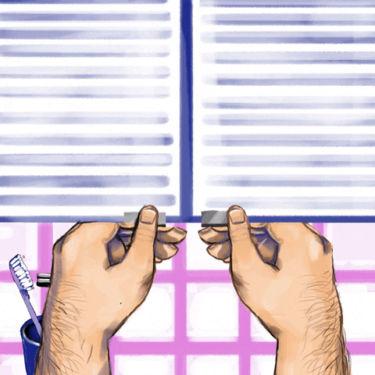
Your Thinking
What are some traits that men may be pressured to display or be in order to be considered “real” men?
Individually, brainstorm a list of traits and share your ideas with the class.
Notes:
Activity 2:
This activity is mean to trigger critical thinking towards traditional expectations on masculinity.
Teachers can use a digital white board to create a comprehensive list of terms that the class generates.
Online Delivery Guide: White Board
Digital white boards allow educators and students to simultaneously add text and images to a single white board document.
While individual teachers will use different online learning systems for student interaction, the most common platforms share similar features.
Suggested Digital Tool:
Digital White Boards are available on Zoom (White Board feature),
Microsoft Teams (Microsoft WhiteBoard feature),
Google Meets (Jamboard feature)
Apart from the suggested tools above, you can also use Google Jamboards (https://jamboard.google.com/) to create a white board. By clicking on the “Share” button can change privacy settings and invite students through e-mail or by sharing a link to collaborate in the same document.

Slide 7
Check Your Thinking
Aggressive
Athletic
Rugged
In control
Strong
Unemotional/Stoic
Bully
Confident
Humorous
Plays contact sports
Heterosexual
Pretentious
Perceiving girls as sexual conquests/objects
Swagger
What other traits did you list that are not included here?
Share these with the class.
Notes:
This list represents some of the characteristics that students might have come up with.

Slide 8
Clarifying Terms
What is your understanding of the following terms?
Objectification
Emotional Stoicism
Notes:
This is an opportunity to unpack some of the terminology in the previous slide. Objectification and Stoicism are unpack here, but other terms can be included based on the educators decision.
Teachers can use a digital Word Wall to capture any new vocabulary in this lesson plan.
Digital Delivery Guide: Word Wall
Word walls help students retain new vocabulary. You might consider creating a digital word wall with the new vocabulary words covered in this session
Suggested digital tool:
Padlet http://padlet.com/
Google Doc https://www.google.com/docs/about/
Zoho Docs https://www.zoho.com/docs/
Accessibility is the key to an effective word wall. Students need to be able to refer back to the definitions with ease. A digital word wall creates an online repository of ideas and concepts. Use the following suggestions when creating a digital world wall.
Choose a platform that allows collaborative editing.
Invite students to the Digital word wall

Slide 9
Clarifying Terms
How does your understanding compare to this definition?
Objectification: the action of treating someone like a mere object.
Emotional Stoicism: controlling emotions; not showing feelings
Notes:
This is an opportunity to unpack some of the terminology in the previous slide. Objectification and Stoicism are unpack here, but other terms can be included based on the educators decision.

Slide 10
Let’s Categorize Our List of Traits
Place each of the traits on your brainstormed list under the headings you think the trait leads to:
Objectification of Women | Homophobia
Emotional Stoicism | Encouragement of Violence
Note not all terms need to fit into each of these categories.
Notes:
Tom Keith, a philosophy and gender studies professor at Claremont Graduate University, identifies four main pillars of toxic masculinity: The objectification of women, homophobia, emotional stoicism, and the encouragement of violence.
Ask students to think about the traits in the list that was created and asked them if they can be placed in one or more of the categories in the boxes.
Most terms will find a place on the charts. Begin a discussion to bring up more terms that can be added.

Slide 11
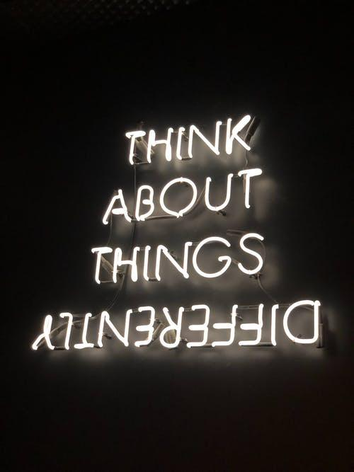
Let’s Extend Our Thinking
Individually, think about…
Which of these traits could cause harm to women, girls, men and boys, and people across the gender spectrum?
How they might harm men of colour?
How they might harm 2SLGBTQ+ Identifying men?
Share your thoughts with the class.

Slide 12
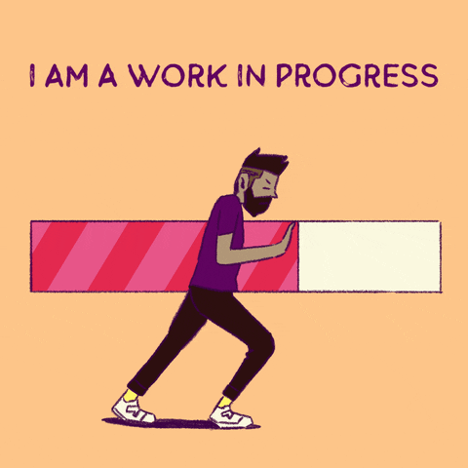
Let’s Extend Our Thinking
How might these traits:
Negatively impact the behaviours of men such as being aggressive, unemotional or in control, on men’s mental health and relationships?
Impact on women by leading to gender-based violence, objectification, sexual violence, child sexual exploitation and sex trafficking?

Slide 13
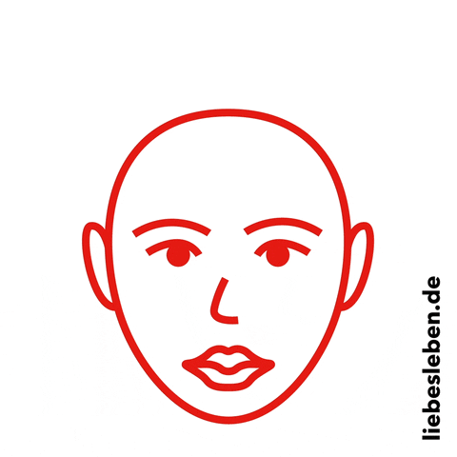
Let’s Extend Our Thinking
How might these traits:
Lead to violence against Queer/Bi/Gay/Trans men that do not follow or possess these traits?
Affect the media representations of masculinity among different cultural groups producing false and harmful stereotypes?

Slide 14
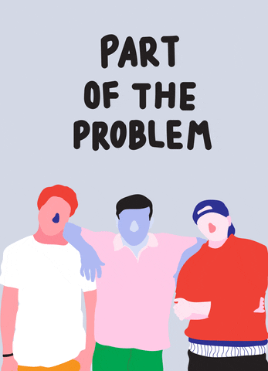
Let’s Extend Our Thinking
Brainstorm alternative “masculine” traits that could make relationships, mental health, and well-being better in your community.

Slide 15
Check Your List
empathy
emotional management
respect
giving importance to consent
uplifting others
respecting when someone says ‘no’
respect for diversity
Did your list include any of these traits? Use the Stamp tool to indicate which ones you included.
What other traits did you come up with that are not on this list?
Share these with the class.
Notes:
Teachers can create a comprehensive list of alternative traits on masculinity using a digital white board.

Slide 16
Consider
How could these make the lives of men better?
How would their relationships with others improve?

Slide 17
What is your thinking now?
To what degree do you think the stereotype of the traditional male leads to:
Place an X on each line to show your response.
Women being treated like objects? Low High Degree | Homophobia (a dislike or prejudice against homosexual people)? Low High Degree
Control over emotions? Low High Degree | Violence against girls, women and members of the 2SLGBTQ+ community? Low High Degree
Notes:
Revisit this activity. Allow students to share how their initial thinking might have changed throughout the lesson plan.

Slide 18
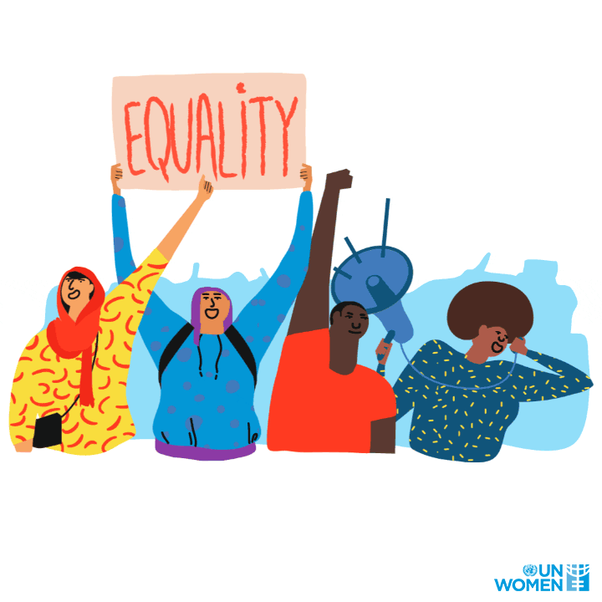
What is your thinking now?
“Young men are often asked to take on character traits and behaviours that are damaging to them and others around them. Stepping away from these rigid expectations is key in building healthier relationships.”
Discussion: What have you learned about challenging unhealthy expectations on masculinity and building healthy relationships?
Notes:
This is the beginning of the Wrap-up in this lesson. It’s important to reiterate that the purpose of these exercises was not at all to judge anyone but rather to find areas of growth to impact people in our lives in ways that are positive and meaningful.
Mention how very often young men are asked to follow characteristics and behaviours that are damaging to them and others around them, and that stepping away from these rigid expectations is key in building healthier relationships.

Slide 19
Help us make a change!
Create a social media post representing a healthy portrayal of masculinity. Share this depiction on social media to increase awareness and help young people overcome these stereotypes.
Notes:
Students will respond to this task at the end of the lesson. See slide 23.

Slide 20
I pledge never to commit, condone, or remain silent about violence against women and girls
Take the pledge online: whiteribbon.ca/pledge
Learn more about White Ribbon at:
whiteribbon.ca
@whiteribboncampaign
@whiteribbon
@whiteribboncanada

Slide 21
Other Optional Activities

Slide 22
Optional Activity 1: Boys Don’t Cry, a White Ribbon PSA.

Slide 23
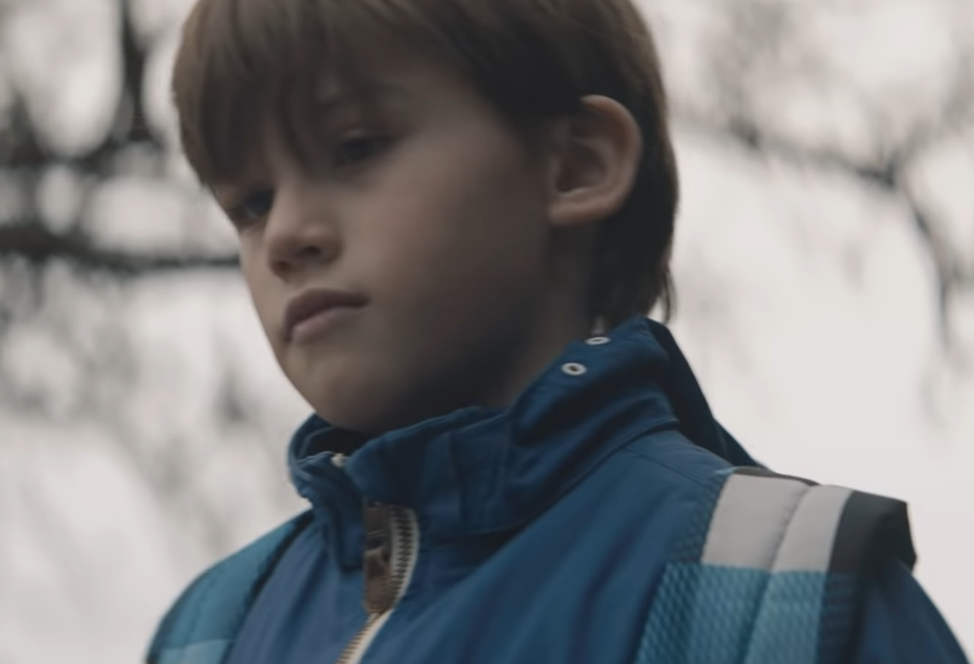
White Ribbon’s PSA
Consider the following questions as you watch White Ribbon’s Boys Don’t Cry PSA:
What is the central message of the video?
What are some examples of unhealthy expectations of masculinity seen in the video?
Have you ever been told any of the messages that the main character receives? (example: “I need you to be brave”, “Boys don’t cry”, “Be a big boy”)
How does the video make you feel?

Slide 24
Let’s Make a Change
What role can we each play to promote healthy masculinities and gender equality?

Slide 25
Optional Activity 2: Healthy/Unhealthy Masculinity Scenarios

Slide 26
Effects of Unhealthy Masculine Expectations
In partners, use the following questions to guide your discussion of your assigned scenario questions:
How might someone with unhealthy negative expectations of masculinity answer the question?
How might it impact the people in the scenario?
Notes:
This section will ask students to share experiences that have the potential to delve into sensitive areas.
The intention of this activity is to make students aware of the effects of unhealthy masculine expectations and foster empathy for those who are often targeted with unhealthy language and behaviour.
Ask students to discuss their assigned scenario using the questions provided and then present their views to the whole class.

Slide 27
Effects of Unhealthy Masculine Expectations
Use the following questions to guide your discussion of your assigned scenario:
How might someone with healthy expectations of masculinity answer the question?
How might it impact differently on the people in the scenario?

Slide 28
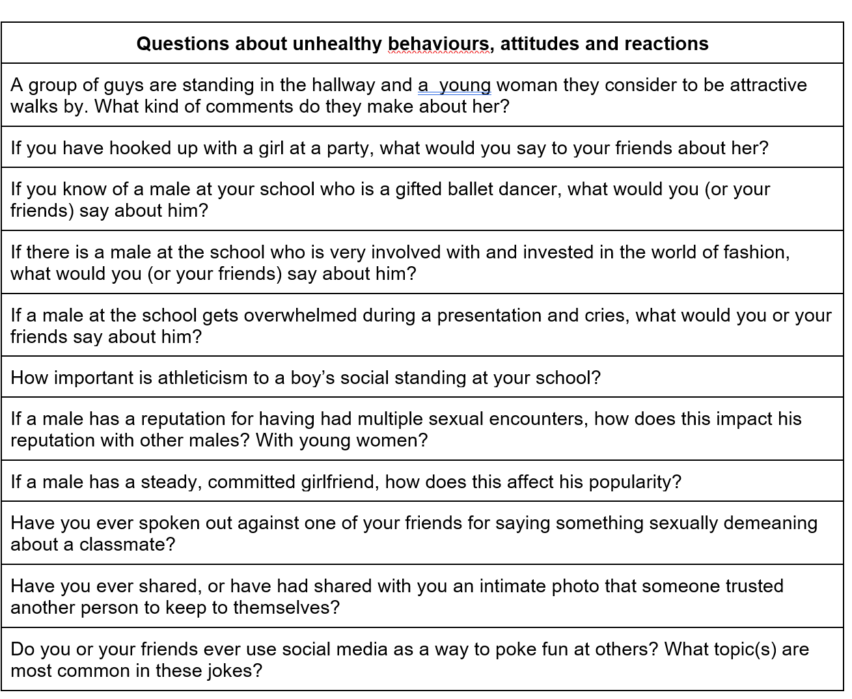
Let’s discuss these scenarios. Present your group ideas to the class and have others share their opinions.
Notes:
These scenarios are part of the original lesson plan found here

