Slide 1
Challenging Unhealthy Representations in the Media
Course: -----------
Notes:
Learning Objectives:
●Reflecting on the gender-based stereotypes
● Learning about the role that online media -in particular social media- has in the development of these stereotypes
Notes for Educators:
Toxic gender-based stereotypes that devalue women and girls have been identified as a root cause of child sexual exploitation and sex trafficking. The media perpetuates many of these negative ideas and our students’ heavy social media/online usage means that they are regularly exposed to harmful images. Students may at first be resistant to the content of this lesson plan, as they are not only consumers of media, but also creators.
In addition, discuss how the 2SLGBTQ+ community is affected by media representations. Often 2SLGBTQ+ women will be represented as “unfeminine”, gay/bi men as “too feminine” and non-binary and trans individuals will be subject to gender regulation and stereotyping.
Encourage critical thinking about how media representations impact men. Men experience pressure to follow unchallenged stereotypes such as being tough, controlling, overtly sexual, strong, independent, and non-emotional. Stereotypes against men differ from sexism because the images of men have to do with men exercising power over women and over other men.
This activity also provides an opportunity to explore how diverse groups of women can be impacted in different ways through the lack of representation and stereotyping.
Online Delivery Guide:
Throughout this powerpoint presentation you will find suggested digital tools and platforms for activity implementation in online spaces.
Optional Activities:
This lesson plan was shortened from its original version. Some of its activities were included as “Optional Activities” at the end of this presentation.
Teacher Supervision:
Online technology allows students to engage meaningfully with both course material and their peers. Due to the sensitive nature of the content, be cognizant of the potential for triggering interactions. Your chosen digital toolset should reflect the maturity and sensitivity of your students. For example, you may prefer classroom discussions as they allow for monitoring of discussion if you have concerns about small group interactions without adult supervision.
Accessing Support Material:
Support material is located throughout the accompanying slide decks. Teachers wishing to make use of them are encouraged to download version(s) to their desktop for distribution to students where applicable. Teachers using learning management systems should upload a version of files for students wishing to work asynchronously. Note that all lessons, with the embedded student materials, are available for downloading as both PDF and Word documents on the wrprevent.ca website.
Curriculum Connections:
English Grade 9 (ENG1D):
1.2 media studies. Interpret media texts, identifying and explaining the overt and implied messages they convey
English Grade 9 (ENG1P):
1.1 media studies. Explain how simple media texts and some teacher-selected complex media texts are created to suit particular purposes and audiences
Visual Arts, Gr 12 (AVI4M):
B2.2 Assess the impact of socio-economic, political, cultural, and/or spiritual factors on the production of art works
B2.3 Assess the impact that the creation and analysis of art works has had on their personal identity and values and their perceptions of society
Gender Studies Gr.11 (HSG3M):
B3.1 Analyse representations of gender in media and popular culture
B3.2 analyse the impact on individuals (e.g., with reference to their self-concept, aspirations, notions of appropriate behaviour, relationships, sense of belonging or alienation) of stereotypical representations of gender in media and popular culture
B3.3 Analyse images of female and male bodies and representations of beauty and fashion in media and popular culture, and describe their impact (e.g., how images of underweight, digitally altered fashion models can contribute to unhealthy eating habits among girls and women; how images showing celebrities who have had a variety of cosmetic procedures can affect individuals’ self-image or the choices they make)

Slide 2
In-school resources:
Canada-Wide Resources:
Canadian Human Trafficking Hotline
canadianhumantraffickinghotline.ca
ENG/FR - Online chat available
Hope for Wellness Helpline
hopeforwellness.ca
Offers immediate help to all Indigenous peoples across Canada. ENG/FR - Online chat available
Content Warning
and Support
Let’s create a class agreement!
Notes:
Content Warning:
For many students this might be their first time discussing sexual exploitaiton and sex trafficking
Remind students that they’ll be discussing a difficult topic and assure them that number one priority throughout the sessions is their well-being.
Remind students that support is available. They can either access school support (social workers, councillors, etc.) or Canada wide resources.
Students should be informed about the presentation content and given the option to not participate in the lesson
Create a class agreement: Ask students share what considerations should be kept in mind to make everyone feel safe (e.g. being respectful towards everyone’s opinions and using respectful language, not joking about sensitive topics, being mindful of how much space we take throughout the session)
Complete this slide with school supports (social workers, counsellors, etc.) available for survivors and/or those who want to make any disclosures, nationwide resources and online information (such as the wrprevent.ca website) can also be made available to students
Creating a class agreement:
It is essential to create a class climate suitable for the seriousness of the topic. Ask students to share what considerations should be kept in mind to make everyone feel safe (e.g. being respectful towards everyone’s opinions and using respectful language, not joking about sensitive topics, being mindful of how much space we take throughout the session, etc.)

Slide 3
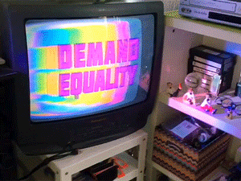
Something for you to think about…
How can we challenge gender inequality, racism and other forms of discrimination in the media?
Notes:
Activity 1:
Slides 3-7 will help you prepare your students for the lesson plan
Note that the question on this slide provides a focus for student learning and we will return to it at the end of the lesson as well.
Ask students to read the question, and let them know they will be asked to answer it at the end of the lesson.

Slide 4
What we will be working towards…
Create an image or video to post on social media that invites other young people to think about how they can challenge gender inequality, racism and other forms of discrimination in the media as a way to address one of the root causes of child sexual exploitation/sex trafficking. Use media images and content that challenge toxic gender stereotypes.
Notes:
Let students know that this will be the culminating task of this lesson plan. YOu will come back to this task at the end.
You can point out to students that images can come from advertisements, social media content, video games, music videos, etc. Students will present their slides/video to the class with an explanation of what they have learned about challenging gender inequality, racism and other forms of discrimination in the media

Slide 5
What is your initial thinking?
“The media often perpetuates toxic stereotypes of both men, women and the 2SLGBTQ+ community.”
To what extent do you believe this statement to be true?
Answer the following Poll anonymously:
Absolutely
Somewhat true
Not sure
I don’t think so
Notes:
Run this poll at the beginning and end of the class to see the extent to which student thinking has shifted as a result of the lesson.
Digital Delivery Guide: Online Polls
Suggested digital tool:
Mentimeter https://www.mentimeter.com
Kahoot https://kahoot.com/
Poll function in your online learning system
Inviting student feedback is a helpful diagnostic tool that can help prompt discussion. There are numerous online polling platforms to choose from. When dealing with sensitive topics, ensure that submissions are anonymous and easily accessible (eg. they do not need registration). The following suggestions should inform your polling:
Familiarize yourself with the setting functions of the platform.
Select the appropriate poll to allow a student to provide original comments.
Adjust the settings as required (eg. You may wish to adjust the number of responses per student.)
Create the quiz prior to the lesson using the question prompts.
When conducting the poll, use the sharing function to display the poll results to students.

Slide 6
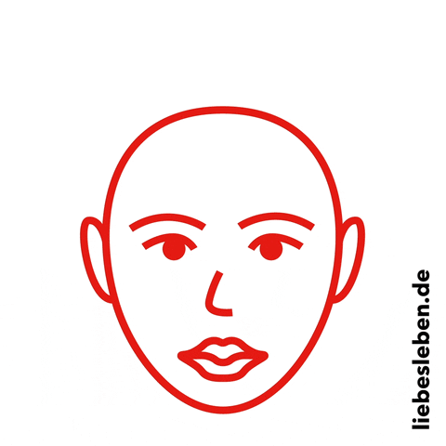
Clarifying terms
What is your understanding of the term stereotype?
Notes:
Activity 2:
These terms (stereotypes/stereotyping) are central to this lesson. You may find it helpful to also discuss vocabulary such as “toxic” and “underrepresentation” which are also mentioned in the lesson. This is an excellent opportunity to use a Word Wall.
Digital Delivery Guide: Word Wall
Word walls help students retain new vocabulary. You might consider creating a digital word wall with the new vocabulary words covered in this session
Suggested digital tool:
Padlet http://padlet.com/
Google Doc https://www.google.com/docs/about/
Zoho Docs https://www.zoho.com/docs/
Accessibility is the key to an effective word wall. Students need to be able to refer back to the definitions with ease. A digital word wall creates an online repository of ideas and concepts. Use the following suggestions when creating a digital world wall.
Choose a platform that allows collaborative editing.
Invite students to the Digital word wall

Slide 7
Clarifying terms
How does your understanding compare to this definition?
Stereotype: a widely held but fixed, oversimplified, mistaken image or idea of a particular type of person or thing.
Notes:
This term (stereotype) is central to this lesson. You may find it helpful to also discuss vocabulary such as “toxic” and “underrepresentation” which are also mentioned in the lesson. This is an excellent opportunity use a digital Word Wall.

Slide 8
Activity: Media portrayals of men and women
We are often bombarded by media images on social media platforms such as Instagram, Facebook, video games, Youtube, etc.
Individually, think about the images of men and women you see in the media, and particularly on social media.
What do the men/women look like?
How do they act?
How do they dress?
Share your thoughts on how the media portrays the “Ideal Man” and the “Ideal Woman”.
Notes:
Unpack these questions with students. Share some examples on how historically masculinity has been associated with violence, war, action, and leadership while femininity has been objectified/sexualized and presented as weak, soft, and secondary.

Slide 9
Activity: Media portrayals of men and women
“Ideal” Woman | “Ideal” Man
Notes:
Complete the table above as a class. Ask students to share their thoughts. You can either edit the table in the presentation or using a digital White Board
Online Delivery Guide: White Board
Digital white boards allow educators and students to simultaneously add text and images to a single white board document.
While individual teachers will use different online learning systems for student interaction, the most common platforms share similar features.
Suggested Digital Tool:
Digital White Boards are available on Zoom (White Board feature),
Microsoft Teams (Microsoft WhiteBoard feature),
Google Meets (Jamboard feature)
Apart from the suggested tools above, you can also use Google Jamboards (https://jamboard.google.com/) to create a white board. By clicking on the “Share” button can change privacy settings and invite students through e-mail or by sharing a link to collaborate in the same document.

Slide 10
Activity: Media portrayals of men and women
Here are some common ways on how the media represents the “ideal” women and men:
Are there other ideas came up with that
are not included in this table?
Ideal Woman | Ideal Man
Thin Flawless White Wears expensive clothing Quiet and agreeable | Rich Athletic Powerful Successful Straight

Slide 11
Let’s reflect
How do these stereotypes make you feel?
What possible consequences could these images have for people who view them?
What groups are often not represented in the media? What are the possible consequences of this underrepresentation?
Notes:
Ask students to reflect on how these stereotypes make them feel. What possible consequences could these images have for people who view them (e.g. poor self-esteem; eating disorders; the objectification of women, etc.)?
What groups are often not represented in the media (e.g. people of colour; Indigenous people; 2SLGBTQ+ people; disabled people)? What are the possible consequences of this underrepresentation? (e.g. poor self-esteem; a feeling of not belonging, etc.)
Explain that teens are often bombarded by media images on social media platforms such as Instagram, Facebook, video games, Youtube, etc.
Explain that these images can create toxic stereotypes of both men and women, and that these toxic stereotypes have been identified as one of the root causes of child sexual exploitation/sex trafficking.

Slide 12
Let’s reflect
“Toxic gender-based stereotypes that devalue women and girls have been identified as a root cause of child sexual exploitation and sex trafficking.”
Consider the ideals we just listed. To what degree do you believe these ideals create toxic gender-based stereotypes that devalue women and girls?
To a high degree
To some degree
Not at all
Notes:
Explain how these images can create toxic stereotypes of both men and women, and that these toxic stereotypes have been identified as one of the root causes of child sexual exploitation/sex trafficking.
Students can be asked to shared their thoughts openly or through an online poll.

Slide 13
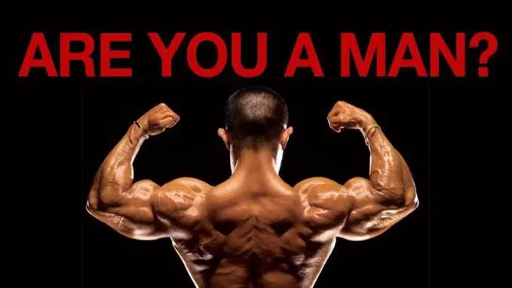
Analyzing gendered media representations
Look at these two media representations of men and women.
How do they make you feel? Is the feeling positive or negative?
Notes:
Activity 3:
Tell the students that they will now look more closely at media representations of men and women that promote toxic stereotypes. Project a current online media image/video that you feel best exemplifies this. This slide contains two examples. The questions in the next slides will help students analyze the images.

Slide 14
Analyzing gendered media representations
Let’s look at those images one more time.
What is the message of the image? Is something being sold? What is it?
How does the size and appearance of the man/woman in the image compare to the size and appearance of an average man/woman? Do the man/woman look like the people you know?
Notes:
The questions on this slide and the next will be used to analyze these images. You may find it helpful to provide a copy of these questions to the students in advance.

Slide 15
Analyzing gendered media representations
How is the man/woman positioned? Does their positioning portray a sense of power or weakness?
Overall, how does this image contribute to toxic stereotypes of men/women?
Have the way people are represented changed during the age of social media?
Notes:
Note that for question #3, women are often shown as looking down or away from the camera., while men are shown as looking up or forward as a statement of power. Women are also often shown as leaning or supported by men, or in forced or coercive positions.

Slide 16
Analyzing gendered media representations
How are media images used to dehumanize and objectify women, especially women of colour, and 2SLGBTQ+ identifying individuals? How do media images such as this contribute to child sexual exploitation and sex trafficking?
Notes:
Discuss how often images are used to dehumanize and objectify women, especially women of colour, and 2SLGBTQ+ identifying individuals, and how this contributes to child sexual exploitation and sex trafficking.
From the “Notes for Educators”, teachers can also discuss how the 2SLGBTQ+ community is affected by media representations. Often 2SLGBTQ+ women will be represented as “unfeminine”, gay/bi men as “too feminine” and non-binary and trans individuals will be subject to gender regulation and stereotyping. This is also an opportunity to explore how diverse groups of women can be impacted in different ways through the lack of representation and stereotyping.

Slide 17
What’s your thinking now?
“Toxic gender-based stereotypes that devalue women and girls have been identified as a root cause of child sexual exploitation and sex trafficking.”
Consider the ideals we just listed. To what degree do you believe these ideals create toxic gender-based stereotypes that devalue women and girls?
To a high degree
To some degree
Not at all
Notes:
Revisit this question either by opening the floor for student participation or running the digital poll again.
Keep in mind the following paragraph from wrprevent.ca
Often missed in conversations about child sexual exploitation and sex trafficking are the societal and cultural dynamics that enable these exploitative transactions.
The objectification of women and girls in mass media is still pervasive. Female-identified individuals are often presented as objects of consumption and disposal. Non-consensual relationships based on the dominance and control of women and girls by men are often glorified. Sexual encounters, money and material objects, such as cars, clothing and jewelry are often presented in western and westernized communities as metrics to determine the value and status of men.

Slide 18
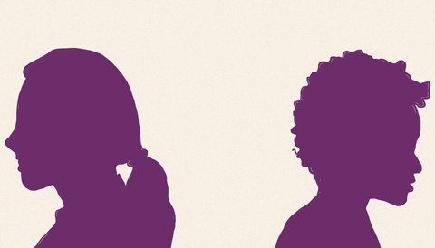
Let’s challenge toxic stereotypes together!
Go online and find media images and content that challenge toxic gender stereotypes
Find content in the form of ads, other social media content, video games, music videos, etc.
Notes:
Activity 4:

Slide 19
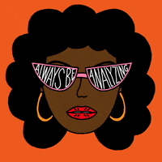
Let’s challenge toxic stereotypes together!
Be sure to explain why you chose these images and content—how it challenges toxic gender stereotypes.
Using the same questions we used to analyze images in class may help.

Slide 20
Let’s challenge toxic stereotypes together!
Share your images and analysis with the class.
Jot down examples of great images and content other groups presented.

Slide 21
Challenging discrimination in the media
Discussion:
How can you challenge gender inequality, racism and other forms of discrimination in the media?
Notes:
Activity 4:
This is the Wrap Up activity in the lesson. After the presentations are complete, ask students how they can challenge gender inequality, racism and other forms of discrimination in the media. Capture student ideas on a digital white board. Some possible answers could include:
1) Create content that challenges toxic stereotypes of men and women
2) Engage with your social media followers in discussions about equity and diversity
3) Refrain from “liking” or “sharing” content that perpetuates toxic stereotypes of men and women
4) Be aware of the companies/individuals who promote toxic stereotypes of men and women and challenge their content
5) Be conscious not to make online comments that reinforce toxic stereotypes of men and women (e.g. commenting on someone’s appearance)

Slide 22
Challenging discrimination in the media
Here are some thoughts:
Create content to post on social media that challenges toxic stereotypes of men and women
Engage with your social media followers in discussions about equity and diversity
Refrain from “liking” or “sharing” content that perpetuates toxic stereotypes of men and women

Slide 23
Challenging discrimination in the media
Be aware of the companies/individuals who promote toxic stereotypes of men and women and challenge their content
Be conscious not to make online comments that reinforce toxic stereotypes of men and women (e.g., commenting on someone’s appearance)
Do you have other ideas you can add?

Slide 24
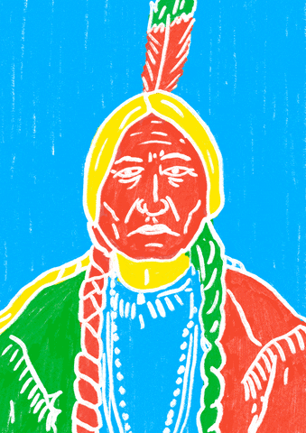
Make a change!
Create an image or video to post on Instagram that invites other young people to think about how they can challenge gender inequality, racism and other forms of discrimination in the media as a way to address one of the root causes of child sexual exploitation/sex trafficking. Use media images and content that challenge toxic gender stereotypes.
Notes:
Educators can assess ways of sharing the content created by students on the school’s social media channels and website

Slide 25
What is your thinking now?
“The media often perpetuates toxic stereotypes of both men, women and the 2SLGBTQ+ community.”
To what extent do you believe this statement to be true?
Answer the following Poll anonymously:
Absolutely
Somewhat true
Not sure
I don’t think so
Notes:
Run the same poll as in the beginning of the lesson
Digital Delivery Guide: Online Polls
Suggested digital tool:
Mentimeter https://www.mentimeter.com
Kahoot https://kahoot.com/
Poll function in your online learning system
Inviting student feedback is a helpful diagnostic tool that can help prompt discussion. There are numerous online polling platforms to choose from. When dealing with sensitive topics, ensure that submissions are anonymous and easily accessible (eg. they do not need registration). The following suggestions should inform your polling:
Familiarize yourself with the setting functions of the platform.
Select the appropriate poll to allow a student to provide original comments.
Adjust the settings as required (eg. You may wish to adjust the number of responses per student.)
Create the quiz prior to the lesson using the question prompts.
When conducting the poll, use the sharing function to display the poll results to students.

Slide 26
What is your thinking now?
What have you learned about challenging stereotyping and other forms of unhealthy representation in the media?
How can we challenge gender inequality, racism and other forms of discrimination in the media?

Slide 27
I pledge never to commit, condone, or remain silent about gender-based violence
Take the pledge online: whiteribbon.ca/pledge
Learn more about White Ribbon at:
whiteribbon.ca
@whiteribboncampaign
@whiteribbon
@whiteribboncanada

