Slide 1
Building Healthy Relationships
Course: -----------
Notes:
Learning Objectives:
●Identifying unhealthy attitudes and behaviour in relationships of all kinds including 2SLGBTQ+ relationships
● Fostering healthy relationship skills that address sexism, consent, and boundaries
● Encouraging critical thinking skills to assess risk in relationships
Notes for Educators:
This lesson is an opportunity for students to learn what separates healthy and unhealthy relationships and create awareness about exploitative behaviour in relationships. Human Trafficking relies on relationships of power, control and dependency and making students aware of this could significantly protect them from being exploited.
Online Delivery Guide:
Throughout this powerpoint presentation you will find suggested digital tools and platforms for activity implementation in online spaces.
Teacher Supervision:
Online technology allows students to engage meaningfully with both course material and their peers. Due to the sensitive nature of the content, be cognizant of the potential for triggering interactions. Your chosen digital toolset should reflect the maturity and sensitivity of your students. For example, you may prefer classroom discussions as they allow for monitoring of discussion if you have concerns about small group interactions without adult supervision.
Accessing Support Material:
Support material is located throughout the accompanying slide decks. Teachers wishing to make use of them are encouraged to download version(s) to their desktop for distribution to students where applicable. Teachers using learning management systems should upload a version of files for students wishing to work asynchronously. Note that all lessons, with the embedded student materials, are available for downloading as both PDF and Word documents on the wrprevent.ca website.
Digital Delivery Guide: Word Wall
Suggested digital tool:
Padlet http://padlet.com/
Google Doc https://www.google.com/docs/about/
Zoho Docs https://www.zoho.com/docs/
Word walls help students retain new vocabulary. Accessibility is the key to an effective word wall. Students need to be able to refer back to the definitions with ease. A digital word wall creates an online repository of ideas and concepts. Use the following suggestions when creating a digital word wall.
Choose a platform that allows collaborative editing.
Invite students to the Digital word wall
Curriculum connections:
Healthy Active Living Education Gr. 9 (PPL1O):
C2.2 Demonstrate an understanding of the skills and strategies needed to build healthy social relationships
Exploring Family Studies Gr. 9-10 (HIF10/20):
B2.2 Describe the characteristics of healthy and unhealthy relationships (e.g., healthy relationships: trust, mutual support, clear limits and boundaries, humour, honesty; unhealthy relationships: mistrust, jealousy, isolation, control, tension)
B2.3 identify resources and strategies that can be used to help develop healthy relationships and resolve conflict in a variety of human interactions (e.g., assertiveness training, anti-bullying programs, strategies for developing empathy)

Slide 2
In-school resources:
Canada-Wide Resources:
Canadian Human Trafficking Hotline
canadianhumantraffickinghotline.ca
ENG/FR - Online chat available
Hope for Wellness Helpline
hopeforwellness.ca
Offers immediate help to all Indigenous peoples across Canada. ENG/FR - Online chat available
Content Warning
and Support
Let’s create a class agreement!
Notes:
Content Warning:
For many students this might be their first time discussing sexual exploitaiton and sex trafficking
Remind students that they’ll be discussing a difficult topic and assure them that number one priority throughout the sessions is their well-being.
Remind students that support is available. They can either access school support (social workers, councillors, etc.) or Canada wide resources.
Students should be informed about the presentation content and given the option to not participate in the lesson
Create a class agreement: Ask students share what considerations should be kept in mind to make everyone feel safe (e.g. being respectful towards everyone’s opinions and using respectful language, not joking about sensitive topics, being mindful of how much space we take throughout the session)
Complete this slide with school supports (social workers, counsellors, etc.) available for survivors and/or those who want to make any disclosures, nationwide resources and online information (such as the wrprevent.ca website) can also be made available to students
Creating a class agreement:
It is essential to create a class climate suitable for the seriousness of the topic. Ask students to share what considerations should be kept in mind to make everyone feel safe (e.g. being respectful towards everyone’s opinions and using respectful language, not joking about sensitive topics, being mindful of how much space we take throughout the session, etc.)

Slide 3
Something for you to think about…
What makes your relationships with others healthy or unhealthy?
Notes:
Activity 1:
Slides 3-5 will help you prepare your students for the lesson plan. Students should be given this question at the start of the lesson so that their experiences throughout the next activities are aligned with this targeted learning.

Slide 4
What we will be working towards…
Place your past, present, or idealized relationships on a very healthy to not very healthy continuum.
Justify your placement of these relationships using the criteria for healthy relationships.
Identify any patterns you see in your unhealthy relationships and use them to consider how you might make better decisions about your relationships in the future.
Very healthy healthy
Not very healthy
Notes:
Please note that Students respond to this task at the end of the lesson. Encourage them to think throughout the lesson plan if their past, present or idealized (how they want their future relationships to be) relationships are characterised by healthy or unhealthy traits.

Slide 5
What is your initial thinking?
How important in our lives is it to identify healthy vs unhealthy relationships?
Very
Important
Not Very
Important
Notes:
Highlight that Human Trafficking relies on relationships of power, control and dependency and that being aware of what unhealthy vs healthy relationships look like, could help them in preventing situations of exploitation.
Do not take up student responses to this question. Students will revisit it at the end of the lesson at which point any continued misconceptions as well as the nuanced nature of power in relationships should be discussed.

Slide 6
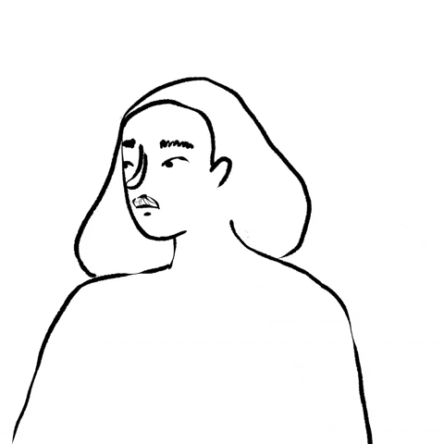
Let’s discuss…
“Learning to have boundaries and good communications skills will help you to have more successful relationships throughout your lives.”
What does this statement imply about what makes a relationship healthy? What is implied in the statement about an unhealthy relationships?
Notes:
Activity 2
Teachers initiate a discussion based on this quotation and the initial thinking of the students. This will begin the process of co-constructing criteria for what makes a relationship healthy with students.

Slide 7
Healthy or Unhealthy? Dating Situations
Consider some of the following scenarios.
What scenarios are “healthy” and which are “unhealthy”?
Notes:
Go through some or all of the scenarios in the box (next slide) and ask students to think if these are examples of healthy or unhealthy relationships and why.
Please note that these scenarios were selected from the 24 original scenarios part of the original lesson plan from White Ribbon’s resource wrprevent.ca

Slide 8
Healthy or Unhealthy? Dating Situations
They block each other on social media during an argument. | He threatens him with “outing” him with his family if they break up | He often tells his partner how much he cares for them.
He tells his friends that he 'scored' with her last night when all they did was hang out. | When they go out with all of their friends to the movies, they sit together but still talk and laugh with the group. They don’t feel threatened but think this is fun. | Your partner pressures you to sell your pictures online, if you don’t they treat you badly
When they are together, they get along well and have fun. When they are in front of his friends, he acts cold and unemotional. | Your partner says they don't like your friends, you can't follow them on Instagram anymore. | Your partner insists on sharing each other’s social media passwords
Notes:
Go through some or all of the scenarios in the box and ask students to think if they are healthy or unhealthy and why.
Please note that these scenarios were selected from the 24 original scenarios part of the original lesson plan from White Ribbon’s resource wrprevent.ca
Note that scenarios are nuanced, situational and contingent on many factors so it might be necessary to make some assumptions. Teachers will need to address and discuss any “grey areas” to encourage critical thinking their your students.
For instance, the scenario "he often tells his partner how much he cares for them", could be positive, but could also be a sign of emotional exploitation and control if there is a presence of violent behaviour in the relationship or if a partner has an unhealthy need for validation.

Slide 9
Consider the following questions
How did the partners or friends communicate?
What was the reason for the conflict?
How might the partners or friends deal with the situation in a healthy way? What might they each say?
What role do gender expectations play in this scenario?
Notes:
Other follow up questions could include:
Did the partners or friends show respect for both themselves and their partner?
Did they respect each other’s boundaries?
Was there consent in their interaction?
What kind of relationship is this?
Is one partner trying to gain financially from the actions of the other?

Slide 10
Healthy Relationships Characteristics
Let’s discuss the following questions:
What do all the scenarios of healthy relationships have in common?
What do all the scenarios of unhealthy relationships have in common?
What are the consequences of having unhealthy relationships? What are the benefits of having healthy relationships?
Notes:
Activity 3
Teachers can use the White Board to capture student thinking around the characteristics of healthy relationships.
Criterial can include: good communication (good listening, expressing your feelings and views); dealing productively and respectfully with conflict etc. Acknowledge that a relationship is a product of the effort both partners put into it.
Teachers can review the “possible questions to ask youth for each scenario” listed in this activity for additional ideas around criteria.
This is another opportunity to post additional terms and definitions to the class digital Word Wall if one is being used
Online Delivery Guide: White Board
While individual teachers will use different online learning systems for student interaction, the most common platforms share similar features.
Suggested Digital Tool:
-Digital White Boards are available on Zoom (White Board feature),
-Microsoft Teams (Microsoft WhiteBoard feature),
-Google Meets (Jamboard feature)
Digital white boards allow educators and students to simultaneously add text and images to a single white board document.
Apart from the suggested tools above, you can also use Google Jamboards (https://jamboard.google.com/) to create a white board. By clicking on the “Share” button can change privacy settings and invite students through e-mail or by sharing a link to collaborate in the same document. Please note that

Slide 11
Why are the following characteristics needed in healthy and meaningful relationships?
Empathy
Loving, equitable and supportive
Active listening
Respect
Emotional management
Transparency/honesty
Good communication skills
Healthy conflict management
Consent
Is there anything in this list you would revise? Are there characteristics we should add to this list?
Notes:
Unpack some or all of the listed characteristics and have students indicate which they agree with.
Afterwards, make any revisions to the existing items and add to the list. Teachers can use a digital White Board to capture student thinking.

Slide 12
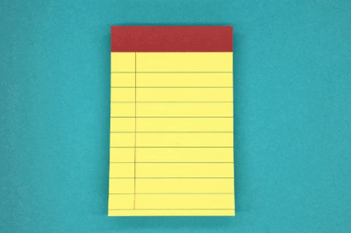
Create Your Own Dating Situation
Use the criteria for healthy relationships to create your own “Is this healthy?” Dating Situation.
Your scenario may describe a healthy or unhealthy relationship.
Share your scenario with the class.

Slide 13
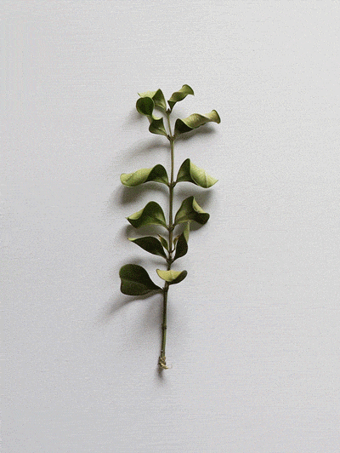
Create Your Own Dating Situation
If you are not the students sharing, decide if the scenario is healthy or unhealthy.
As a class discuss if the shared scenario is healthy or unhealthy. Be sure to share your position and justify it using the criteria for healthy relationships.

Slide 14
Unhealthy Relationship: Where to Get Help
In School:
In the Community:
Notes:
Activity 4
Remind students that there is plenty of support for folks of all ages experiences abuse within intimate relationships.
Ask students to identify where someone could go or phone if they were in an unhealthy relationship. Teachers can co-construct this slide with their students. Examples in school can include a teacher, guidance department, friend, administration etc. Examples in the community can include an adult they trust, a local crisis centre, a women’s shelter etc.

Slide 15
What is your thinking now?
How important in our lives is it to identify healthy vs unhealthy relationships?
Very
Important
Not Very
Important
Notes:
Activity 5
Remind students of this question, which was brought up at the beginning of the session. Ask them to share their thoughts

Slide 16
Can you answer this question now?
What makes your relationships with others healthy or unhealthy?
Notes:
Students should be able to successfully answer this question at the end of the lesson.
This question can be used as an exit ticket to check for student understanding and/or achievement of the lesson goal.

Slide 17
Based on what we just learned
Place your past, present, or idealized relationships on a very healthy to not very healthy continuum.
Justify your placement of these relationships using the criteria for healthy relationships.
Identify any patterns you see in your unhealthy relationships and use them to consider how you might make better decisions about your relationships in the future.
Very healthy healthy
Not healthy
Notes:
Please note that Students should individually reflect about this question. Open the floor for students to ask questions or share their experiences.

Slide 18
I pledge never to commit, condone, or remain silent about gender-based violence
Take the pledge online: whiteribbon.ca/pledge
Learn more about White Ribbon at:
whiteribbon.ca
@whiteribboncampaign
@whiteribbon
@whiteribboncanada

